Slide 1
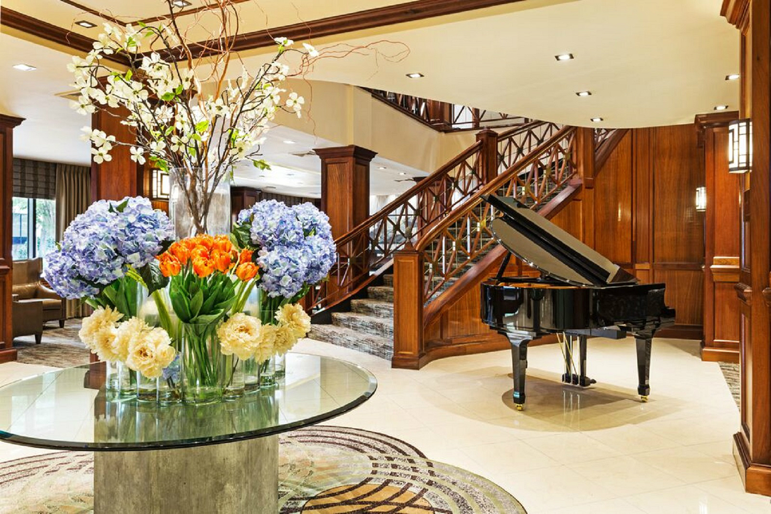

Slide 2
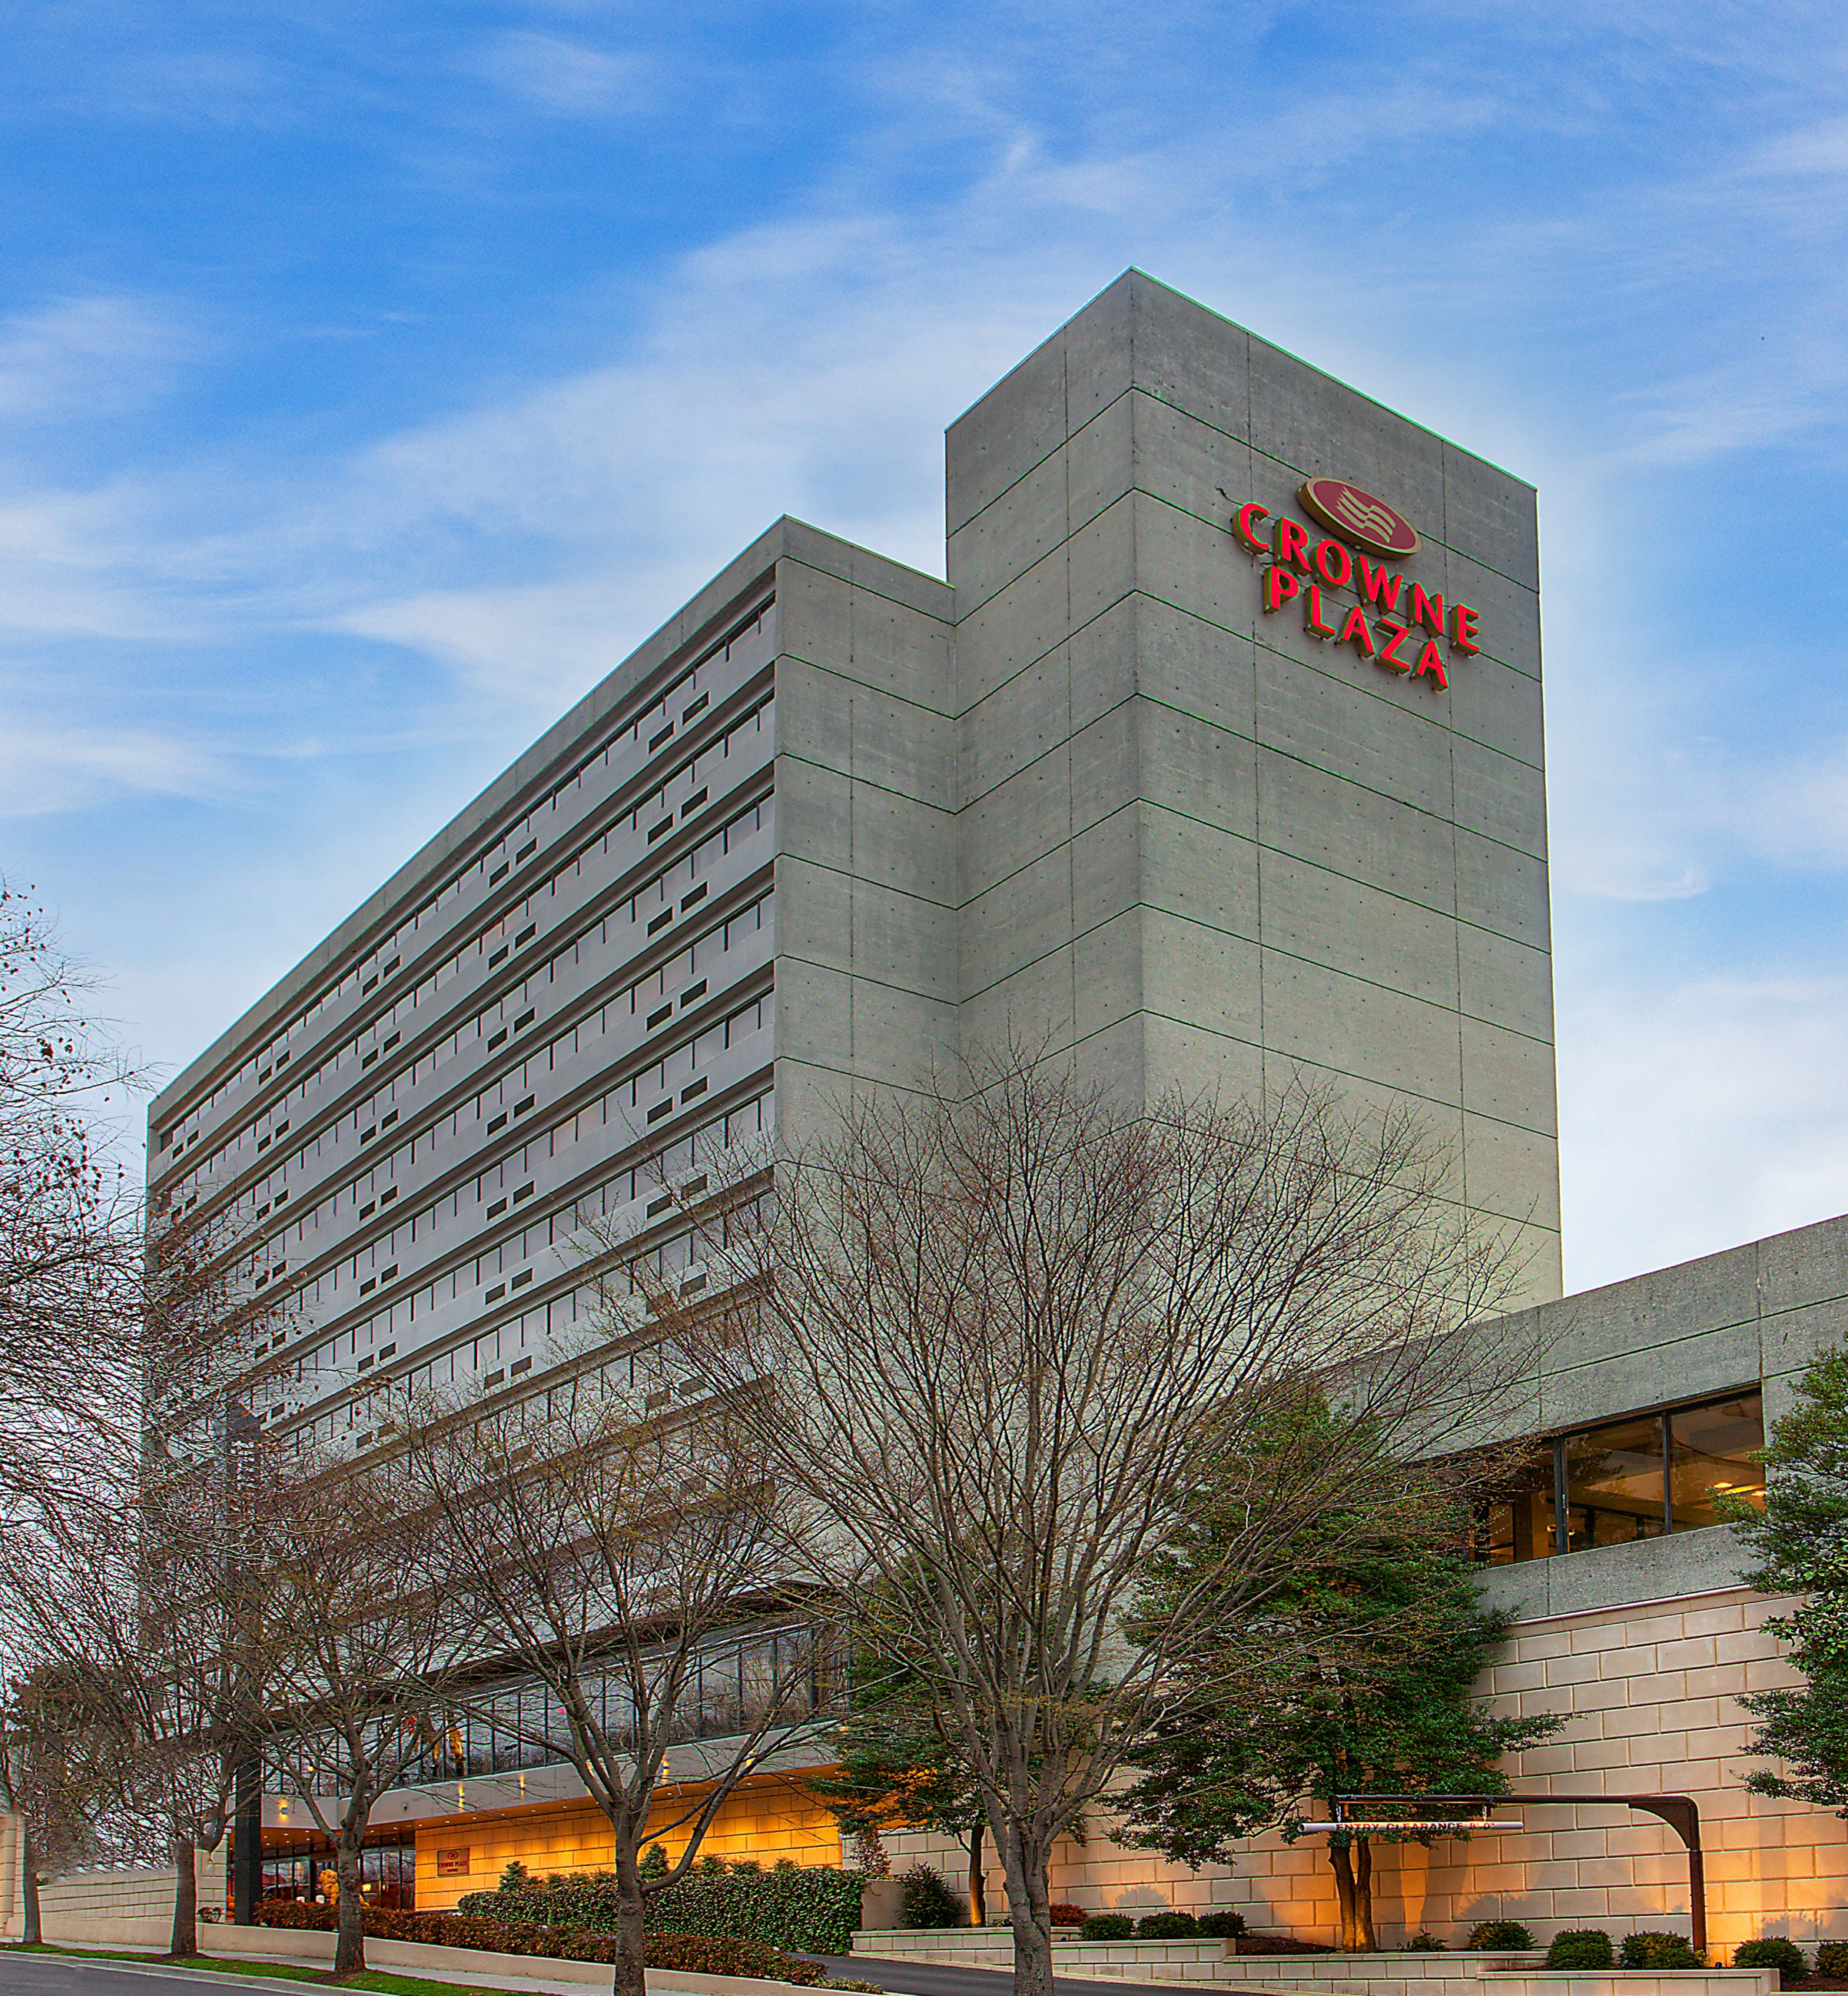
Welcome To
Crowne Plaza Knoxville
Downtown University
A Stylish Downtown Hotel In Knoxville, TN
FPO
Combining luxurious comfort with quiet sophistication, Crowne Plaza Downtown Knoxville offers a home away from home in the heart of the city. Our prime location close to the University of Tennessee and Knoxville's largest offices and corporate campuses makes us one of the best hotels in Knoxville for business travel.
401 W Summit Hill Dr.
Knoxville, Tennessee
37902
(868) 522-2600
www.crowneknox.com

Slide 3
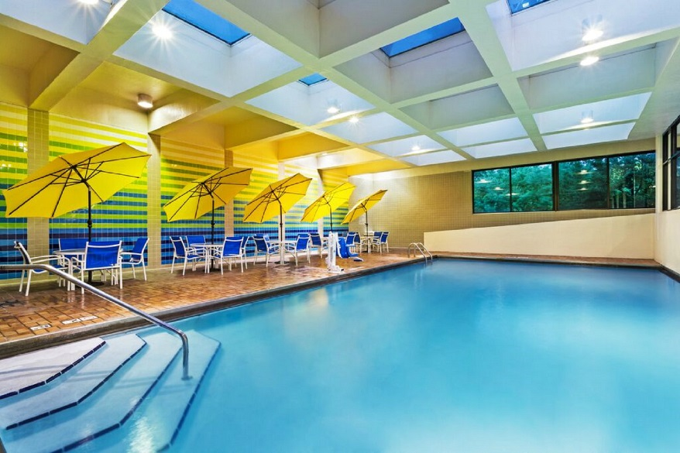
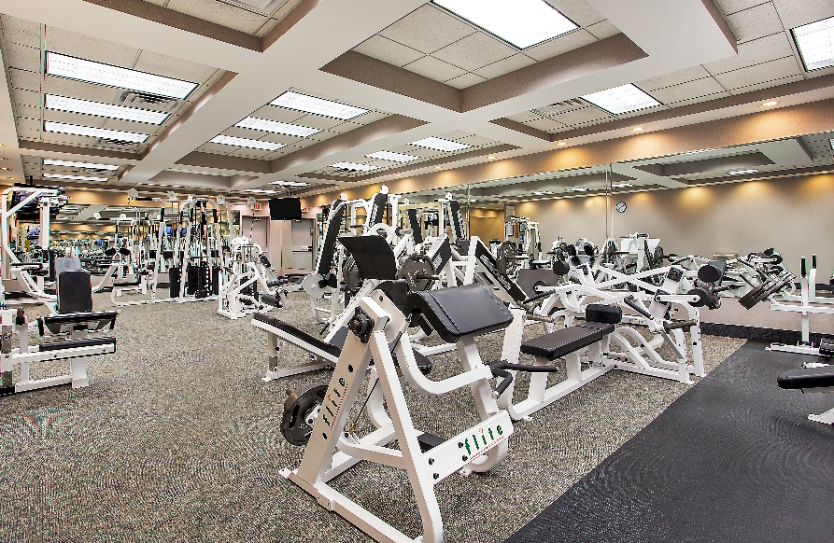
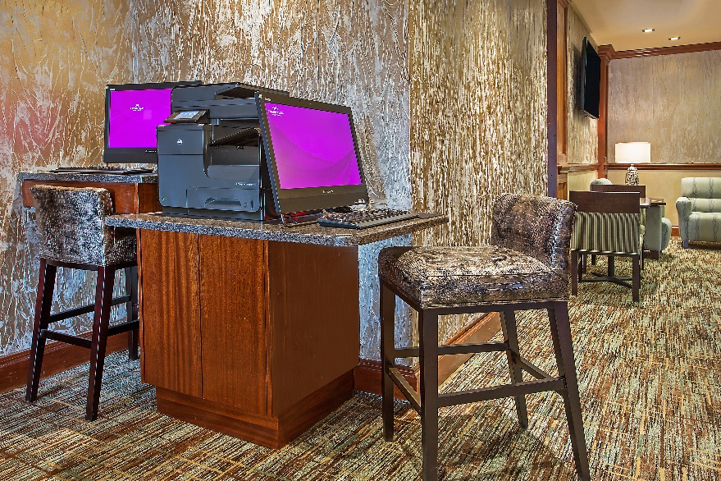
HOTEL AMENITIES
From our large two-story gym and heated pool to our thoughtful aromatherapy sleep kits, we've made every effort to provide you with a happy, healthy stay that emphasizes wellness, relaxation and productivity. Enjoy free high-speed Wi-Fi in all rooms and common areas. Take advantage of our business center and meeting spaces to get some work done during your stay. And, start or end your day with a satisfying meal at Mahogany's, our onsite restaurant. We also offer an extensive room service menu and "The Library" our full service lobby lounge for those on the go.
Indoor Pool
Wake up with some laps in our heated pool,
or take the kids for an afternoon swim.
Fitness Center
Our 2 Story, 3,000 sq.ft. gym includes fitness equipment includes elliptical machines, treadmills, stair climber, stationary bikes, rowing machine and free weights.
Business Center
Get your work done in our 24 hour Business Center.
FPO

Slide 4
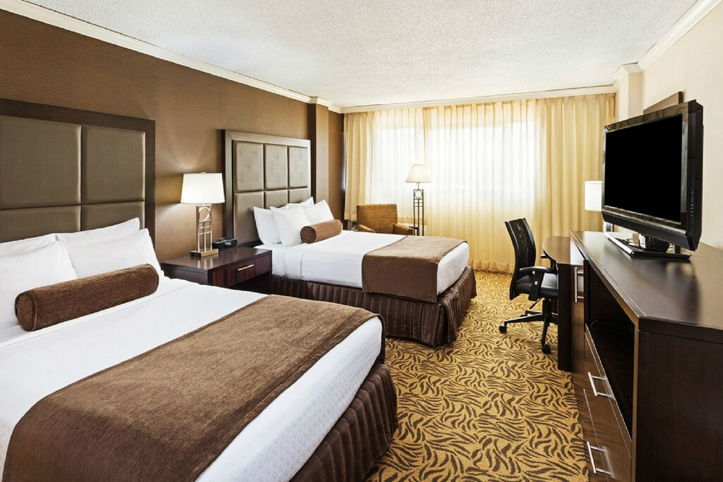
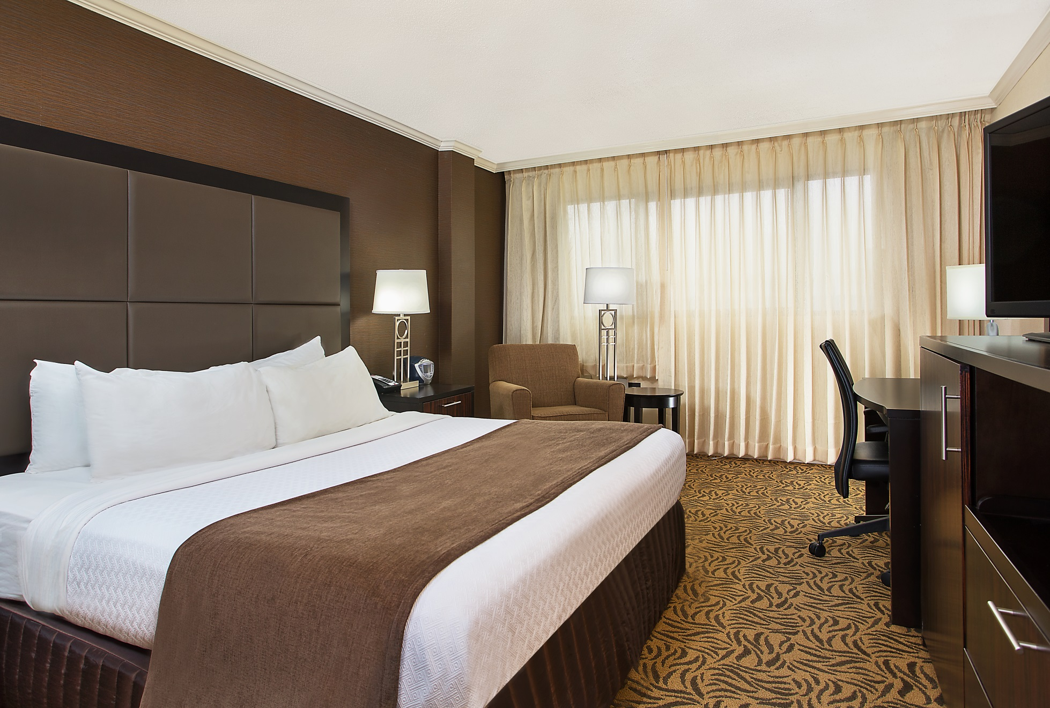
ROOMS
Guests absolutely love the amenities included in our chic, comfortable guest rooms, especially the relaxation sleep kit you'll find on your pillow each night. It includes aromatherapy lotions and spritzes that help you get a good night's sleep in our plush Sleep Advantage® beds. High-speed wireless Internet access is complimentary, as are premium cable channels on the flat-screen high-definition television. Choose from king, queen or double beds, all of which are firm yet soft for a healthful, supportive rest. Traveling with your four-legged companion? They are welcome to stay in our pet-friendly Knoxville, Tennessee hotel.

Slide 5
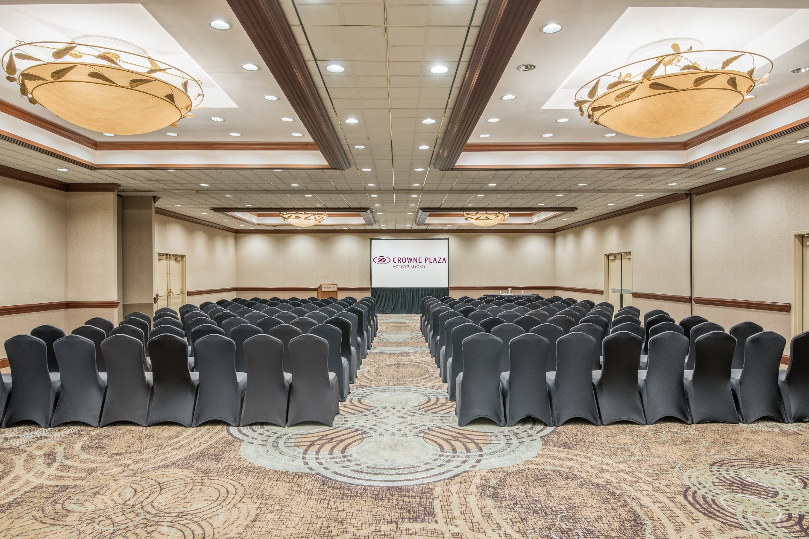
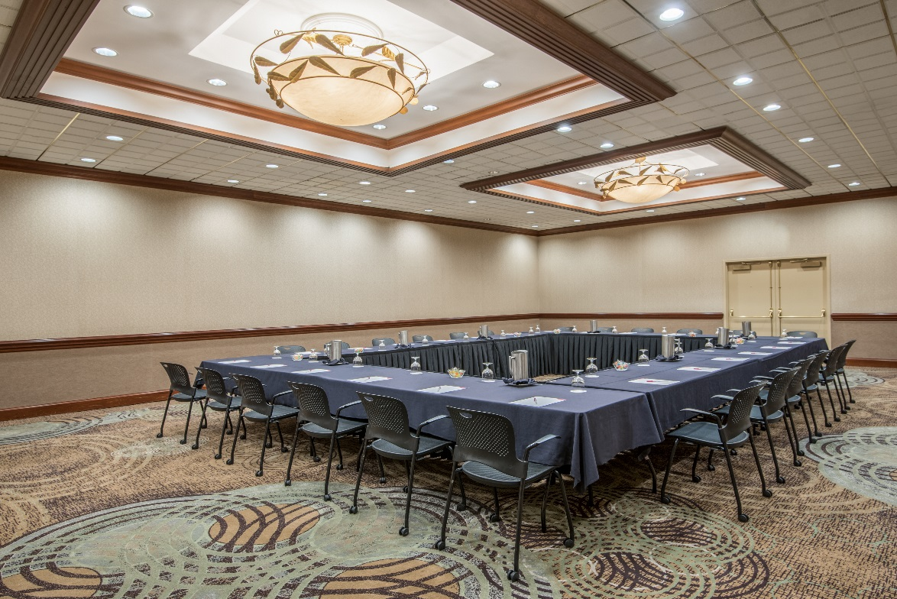
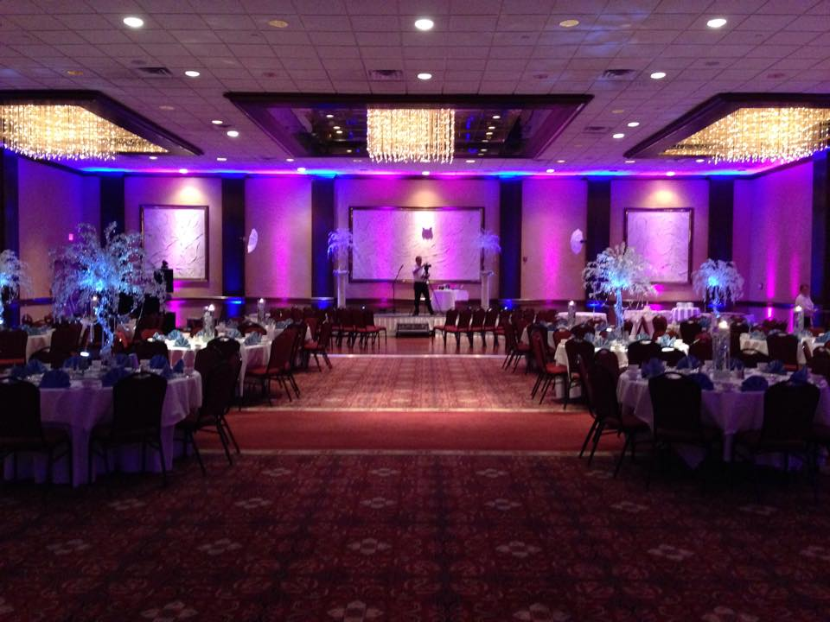
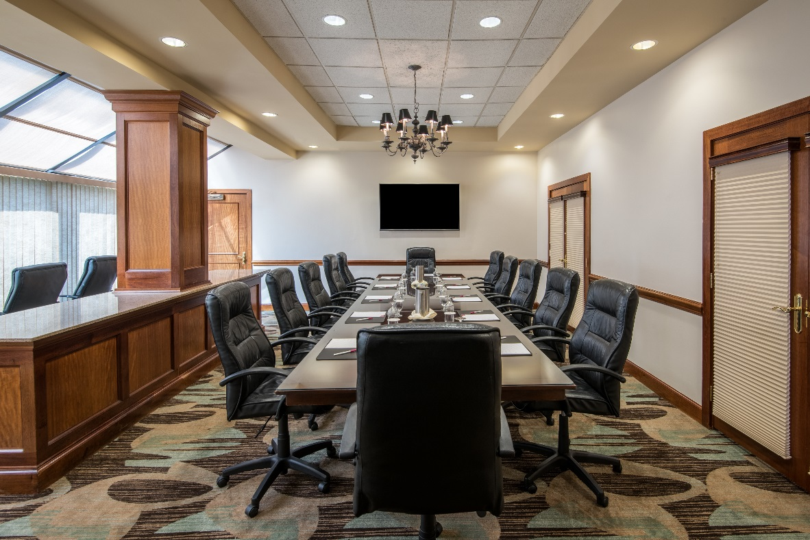
MEETINGS & EVENTS
Whether it's an important corporate conference or a special wedding banquet, Crowne Plaza's meeting and event venues in Knoxville offer the perfect combination of old-world elegance and dynamic modern amenities. With over 15,000 sq. ft. of event space that can be converted into seven dedicated boardrooms, we can accommodate everything from rehearsal dinners and weddings to corporate presentations and meetings. We also offer services including catering and state-of-the-art audio/visual technology, so you can make a great impression on your guests, whether it's a PowerPoint presentation or a slideshow of the happy couple. With our Crowne Meetings Director as your personal planner for an event, you take ease in knowing everything is covered.
SERVICES
Catering
Business center
Audiovisual equipment
On-site restaurant
High-speed Wi-Fi
Valet & self parking
FACILITY SPECS
3,432-sq-ft Summit I
2,156-sq-ft Summit II
6,336-sq-ft Summit Grand Ballroom
484-sq-ft Executive Boardroom 1
240-sq-ft Executive Boardroom 2
1,320-sq-ft Salon A
1,628-sq-ft Salon B
1,320-sq-ft Salon C
4,268-sq-ft Tennessee Ballroom

Slide 6
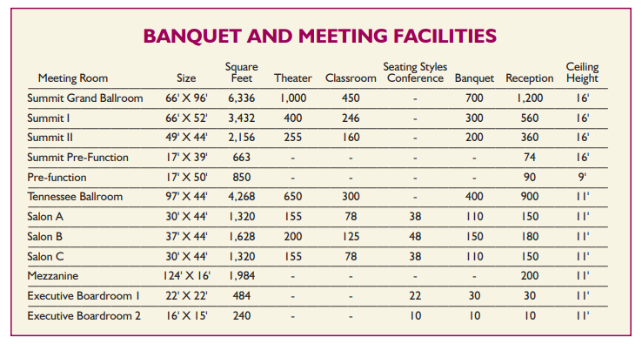
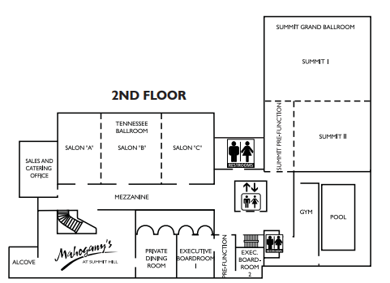
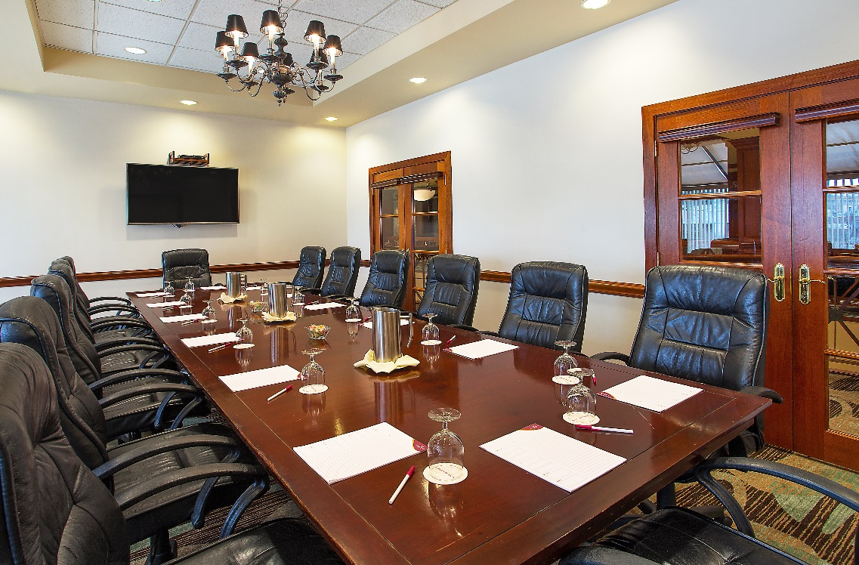
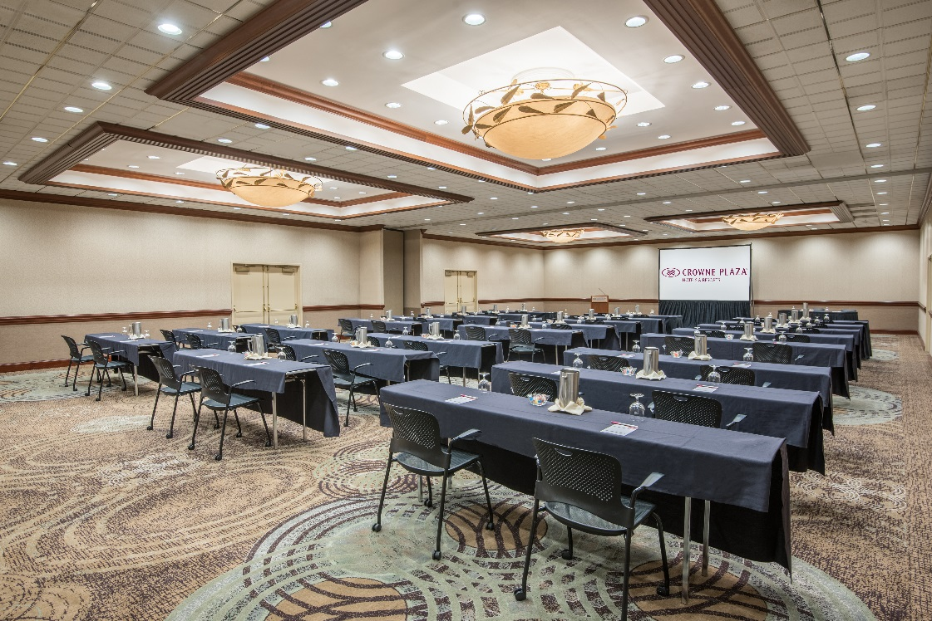
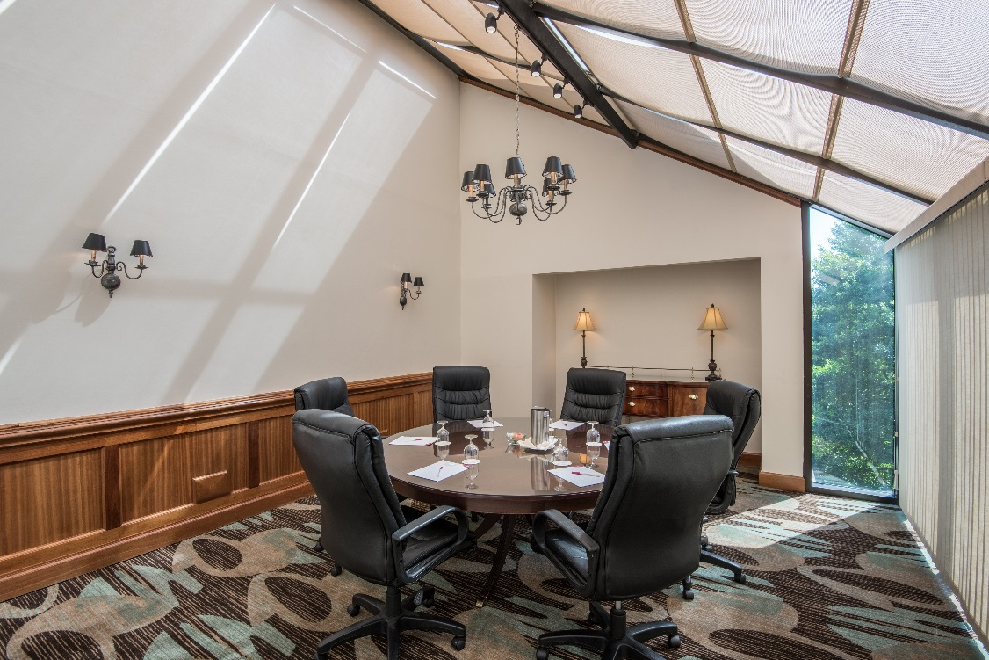
MEETINGS & EVENTS

Slide 7
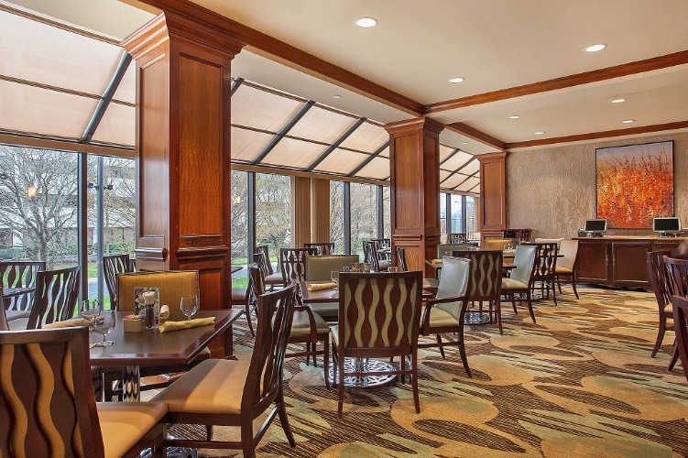
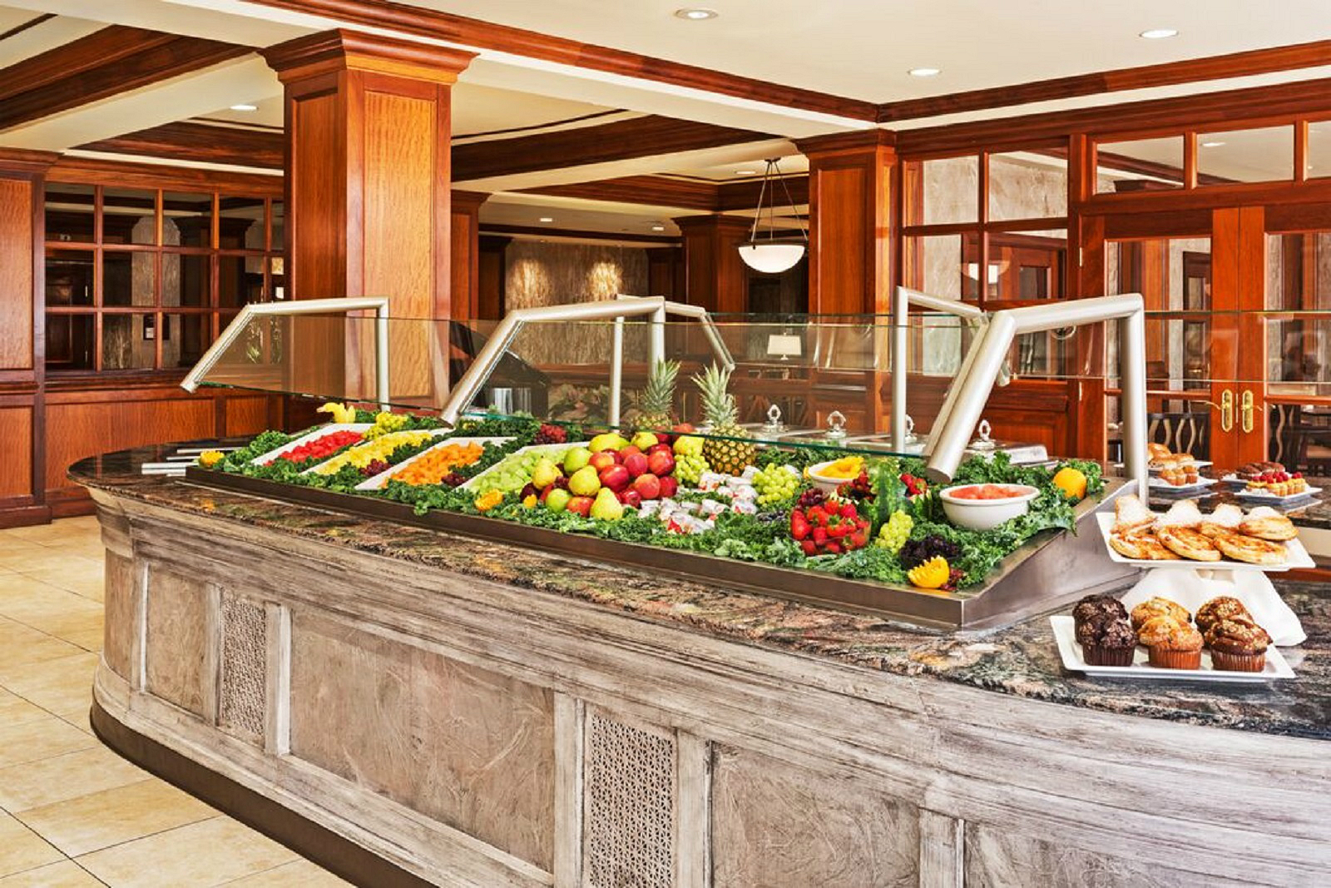
DINING
Mahogany's Restaurant
Offering sophisticated American cuisine with a Southern flair, our onsite restaurant Mahogany's is one of the best restaurants in Knoxville for a hearty breakfast or satisfying lunch or dinner. Mahogany's is also famous for our Friday Prime Rib and Seafood Buffet offering a grand selection of chef-carved prime rib, oysters on the half shell, smoked salmon, North Carolina trout, boiled shrimp, steamed mussels, and sides.
FPO
Friday Night Prime Rib & Seafood Buffet
Get a taste of Knoxville’s finest seafood in a casual, relaxing atmosphere from 6 pm to 9 pm.
Seafood Display
Carving Station
Pasta Station
Hot Entrees
Dessert Station

Slide 8
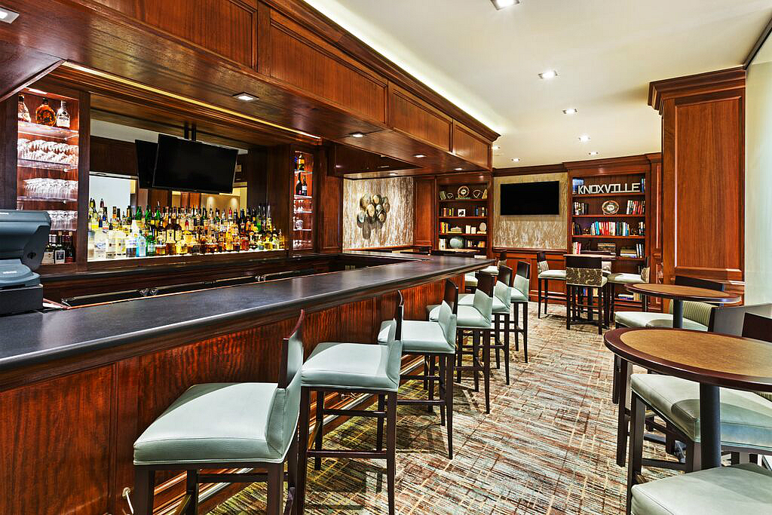
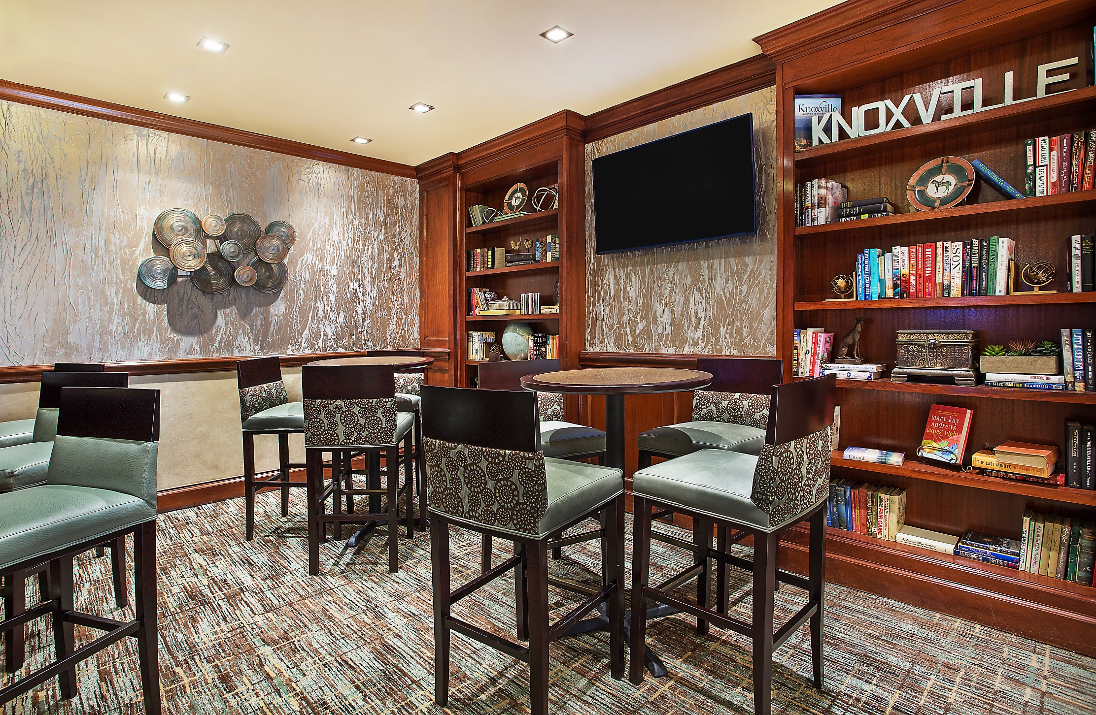
DINING
Library Lounge
Relax with a drink at the ‘The Library’ our full service lobby bar & lounge.

Slide 9
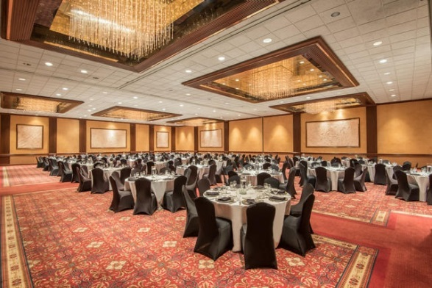
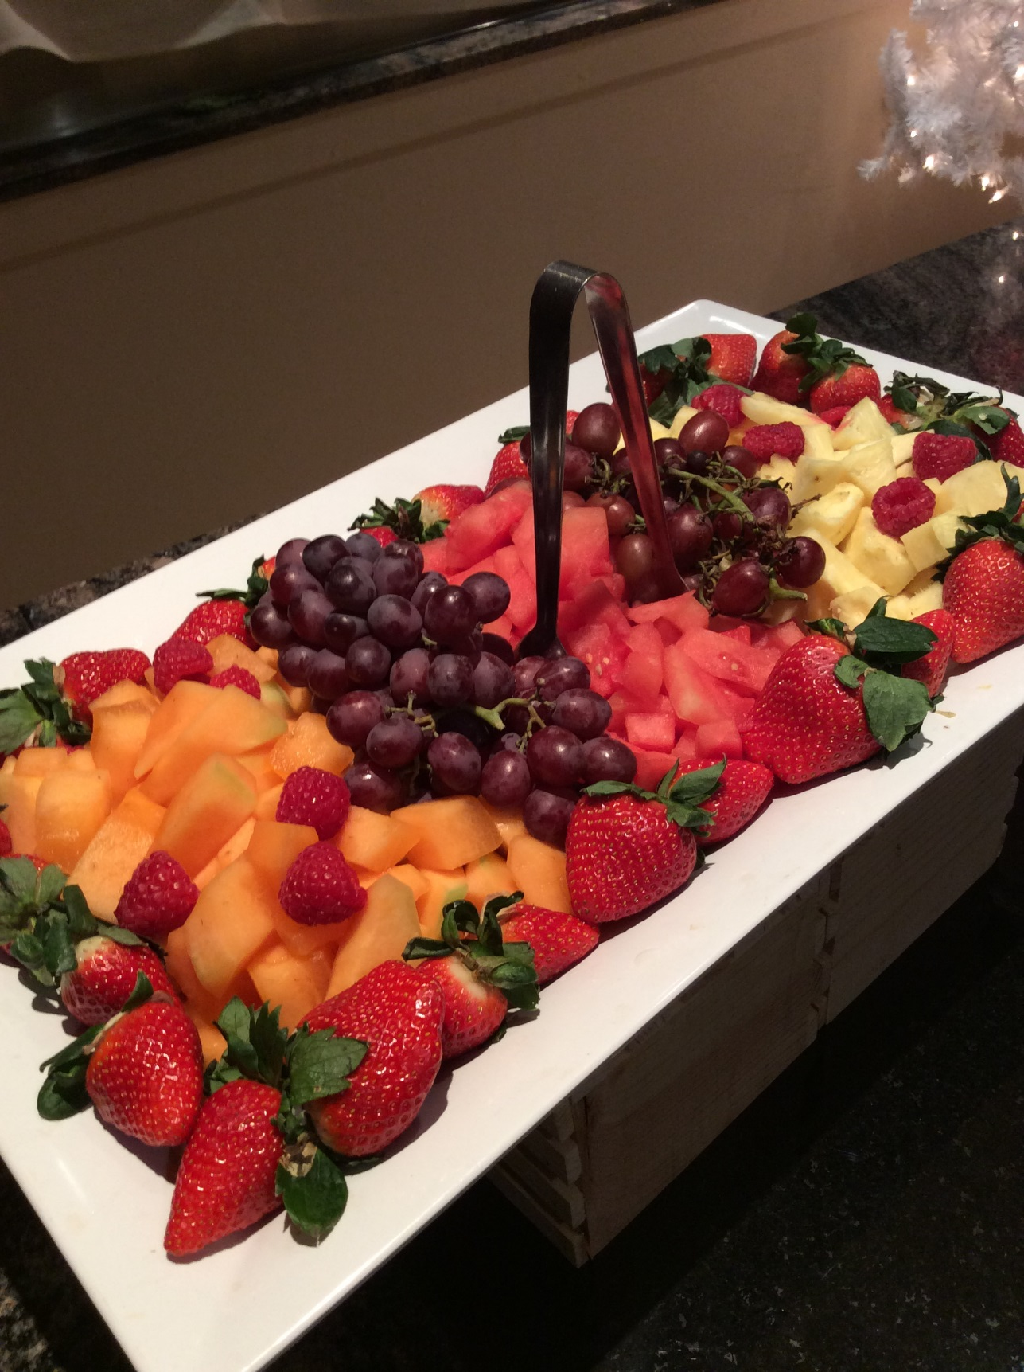
ON SITE & OFF SITE CATERING
Let our professional catering team help craft the culinary details of your meeting, reunion, convention, or wedding down to the last bite. With space for events ranging from 12 to 1,200 guests, we can cater everything from the simplest meeting to the most elegant reception. Enhance your event with themed breaks, a seated dinner, a buffet, or open bar. Crowne Plaza Knoxville's culinary team can also take care of any offsite catering needs for area events and gatherings.

Slide 10
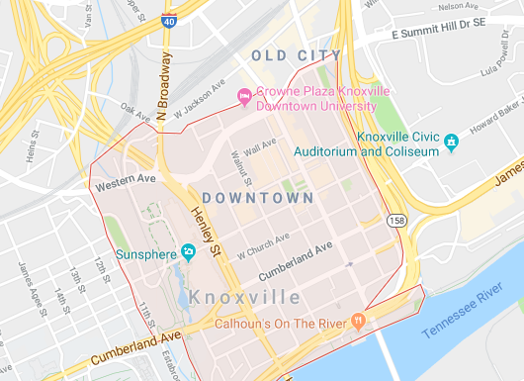
LOCATION
Stay in the heart of Downtown Knoxville, Tennessee, within walking distance of fabulous restaurants, bars and shops, Enjoy an authentic college town spirit from our hotel near the University of Tennessee and the city's culture, nightlife, sports and events. You'll find lots to see and do close to Crowne Plaza Knoxville Downtown University, including the Market Square Farmers' Market, Knoxville Convention Center, and the Sunsphere at World's Fair Park.
401 W. Summit Hill Dr.
Knoxville, TN 37902

Slide 11
For Information Contact: Jeff Shrewsbury 865-522-2600 ext. 2345 jshrewsbury@crowneknox.com

