Slide 1
Hilton Knoxville

Slide 2
The Hilton Knoxville has been in business since 1981. We are a full-service Hilton-brand hotel since its opening and has operated under the current ownership since 2014
The Hilton Knoxville is owned by The Buccini/Pollin Group and managed by PM Hotel Group. Both are in Chevy Chase, Maryland.
PM Hotel Group is a top 20, leading hotel management company which manages nearly 40 hotels with over 9,000 rooms throughout the United States. Hilton Knoxville is but one of the many Hilton brand properties managed by PM Hotel Group as well as Aloft, Canopy, Doubletree, Embassy Suites, Hampton, Hilton Garden Inn and Homes 2 Suites.
.

Slide 3
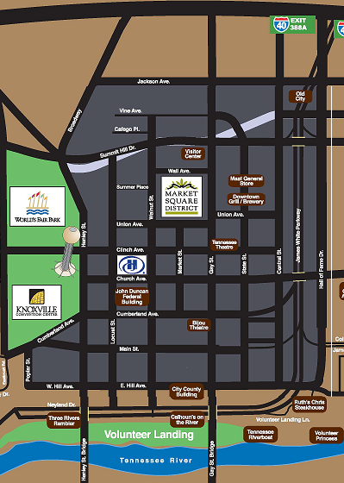
Location-Location-Location!
Hilton Knoxville is located at 501 W. Church Avenue
Conveniently located in downtown Knoxville
-Less than a mile to campus
-20 minutes from McGhee Tyson Airport
-40 minutes to Oak Ridge, TN
-Walking distance to shopping and over 30 restaurants

Slide 4
Accommodations
320 modern and well-appointed guest rooms, with executive level and parlor upgrades. Spacious guest rooms offering brand new bedding & décor
Bath amenities, Single serve coffee maker, iron & board, closet safes, hair dryers and refrigerators in each guest room

Slide 5
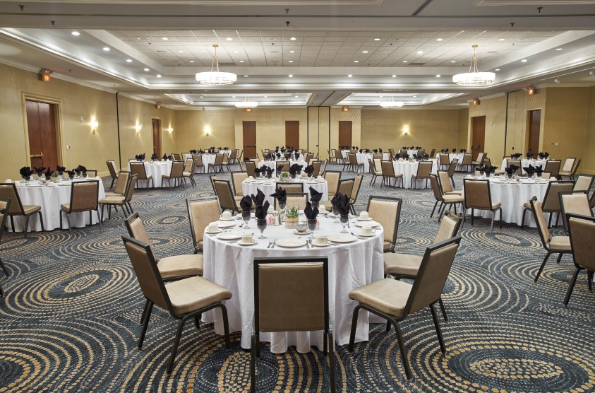
MEETING AND BANQUET SPACE
Hilton Knoxville is a prime downtown location,
offering over 14,000 square Feet of flexible and spacious meeting Space ideal
for private functions, board meetings, and conferences.
Our Catering and Culinary Team will provide fresh culinary creations featuring regionally-sourced ingredients.
Smallest Meeting
Room is
600 square feet
Largest Meeting Room is
6,976 square feet

Slide 6
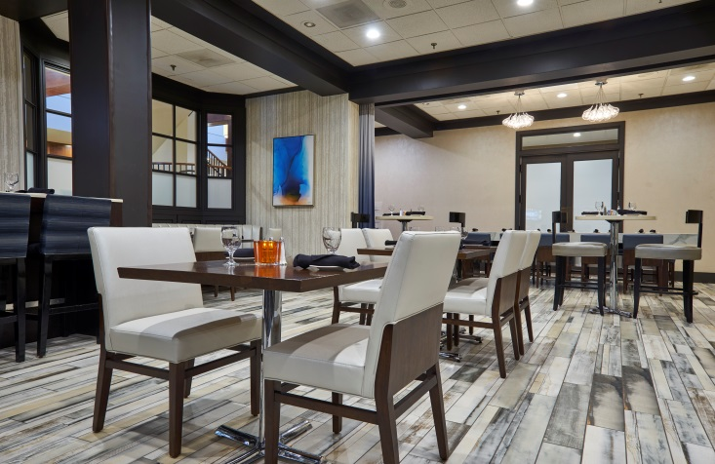
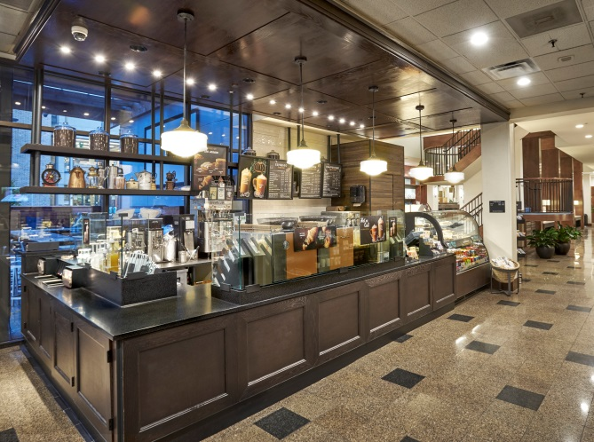
DINING OPTIONS
Sample classic comfort cuisine at the
Marble City Kitchen
…or enjoy a light snack at the full-service Starbucks store..
…and treat yourself to a cocktail at The Firefly our outdoor patio in the
heart of downtown Knoxville

Slide 7
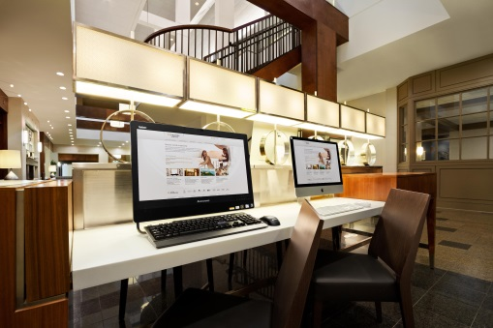
Services
Complimentary high-speed wireless internet access in all guestrooms, lobby & meeting space
Pet Friendly
100% smoke-Free Hotel
Full-Service Business Center & Gift Shop
In-Room Dining
Valet and self parking available
Newly-expanded exercise facility for the exercise enthusiast
Outdoor swimming pool and sundeck
Hilton HHonors® Concierge Level & Lounge offering Breakfast & evening Hors D’oeuvres
ADA Compliant

Slide 8
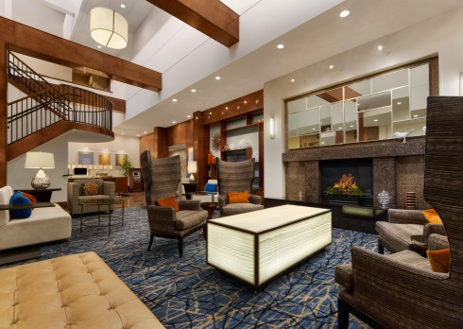
Exclusive Benefits if you book with Hilton Knoxville
Full service Hilton –brand hotel
CONUS rates with last room availability for standard room types if booked at least 21 days prior to arrival
Complimentary self –parking for overnight guests as well as local guests attending meetings, conference or events at the hotel
Group room blocks reserved at CONUS rates (based on availability)
15% discounted rates on blackout dates
15% off Catering and Banquet Menus – reduced service charge @ 20%

Slide 9
Next Steps…
Contact the Hotel
Check Availability
Complete the Hotel Event Form
Sign and return the form to confirm your arrangements!

Slide 10
Contact Information
Tracy O’Connor
Sales Manager
Dustin Gibson
Catering Sales Manager

Slide 11
Resources
Group Room/Meeting Needs – Tracy O’Connor
toconnor@hiltonknoxville.com
Banquet & Event Space Needs-Dustin Gibson
dgibson@hiltonknoxville.com
Hotel Event Form
Hilton Knoxville Website
www.hiltonknoxville.com

