Slide 1
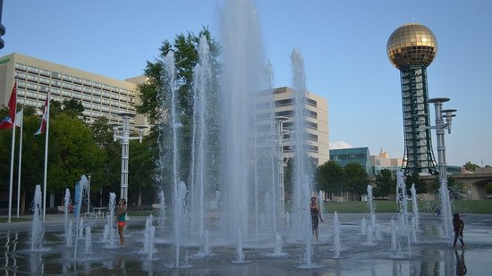
Holiday Inn World’s Fair Park
525 Henley Street Knoxville TN 37902
865-522-2800
www.knoxvilleholidayinn.com

Slide 2
At A Glance
We Are Not Your Grandpa’s Holiday Inn
Secure self-parking on-site
Beautiful location on World’s Fair Park
Three blocks to market square
Complimentary shuttle within a 5 mile radius of hotel
FairGrounds Coffee Bistro and Sundries
Skilled baristas
Grab and Go food and beverages
UT apparel and collectibles
Windows on the Park restaurant and lounge
In-room dining

Slide 3
At Your Service
Group Accommodations
Meetings / Events
Group room blocks of 10 rooms or more
286 sleeping Rooms
Including 7 suites
Park-side and City-side
Keurig coffee makers in-room
Refrigerators in-room
Microwaves on every floor
Complimentary wireless internet
10 ADA rooms
Transient Accommodations
Single reservations - Not associated with a group
16,000 square feet of conference space
Two ballrooms
Break-out rooms
Conference room
Private Dining Room
Off-site catering license – Ideal for…
Sunsphere
World’s Fair Park and Amphitheater
Knoxville Museum of Art
Seasoned banquet staff
Talented culinary team
Creative menu selections
Inventive custom options
Take a virtual tour

Slide 4
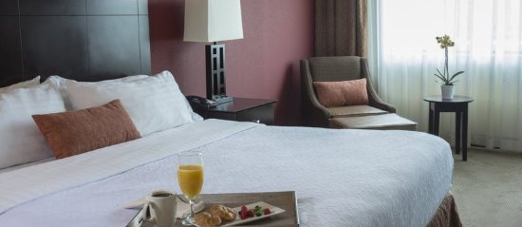
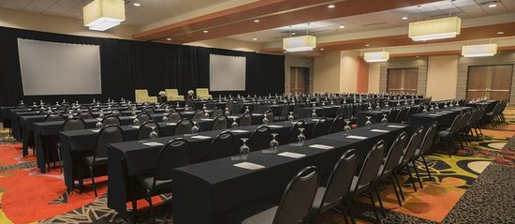

Slide 5
What University Peers Are Saying
I have worked with the team at the Holiday Inn World’s Fair Park for various conferences over the past few years.
From start to finish, the staff has been professional, courteous, and helpful. Erica is quick to respond to any questions, needs or concerns that we have pre-conference, while the banquet and setup team is on-site to ensure our conferences run smoothly and seamlessly.
We have several conferences booked with this property in 2018 and beyond and are always delighted to work with such an outstanding team of professionals.
Holiday Inn Downtown were so accommodating for our needs.
They provided a shuttle for us to go to and from the university so our attendees did not have to find their way from downtown to the conference. We had the best experience with the HI Downtown.
What Differentiates Holiday Inn from the rest …

Slide 6
For more than 20 years I’ve hosted events in various downtown hotels. The Holiday Inn World’s Fair Park and the Park Pavilion is an excellent choice for anyone considering hosting an event and/or needing a block of rooms.
Through the years the staff has been efficient and helpful at all times. From the chef, wait staff, sales, catering team, and management; the entire staff are meticulous in their planning, providing delicious food, and service. Our events require months of extensive planning and need detailed execution. The sales, catering and conference service staff are very knowledgeable, professional and well aware of what works best in their venue. Information provided allows clients to make informed decisions.
The sales and catering staff and our team work in a collaborative manner with one goal in mind - making attendees feel welcomed the minute they step onto the hotel’s property.
We have an excellent working relationship and I look forward to opportunities when we can work
together.
I have had the pleasure of working closely with the Holiday Inn World’s Fair going on 10 years now.
The Management and staff consistently demonstrate an incredible capacity for hotel operations, finance, and sales & marketing making them extremely easy to work with.
The Holiday Inn World’s Fair Park consistently does what needs to be done with both a high level of integrity and professionalism.
It’s our “BE THE DIFFERENCE” approach!

Slide 7
A Convenient
Collaboration
UT Procurement has negotiated all contracting details
Outlined in PO # 5500007637
UT Planners are now able to sign room block agreements and Event BEO’s
Outlined in PO # 550007637
Simply call Kelly or Erica with your details and we’ll send you a customized agreement
Direct Bill has been established for University of Tennessee
Written authorization is required by each department for anything direct billed
Transient reservations must have department authorization prior to direct billing
Detailed bills will be sent directly to the contracting department within a few days after departure

Slide 8
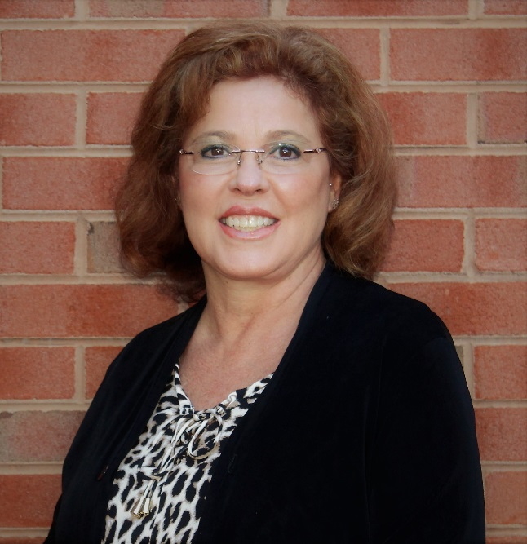
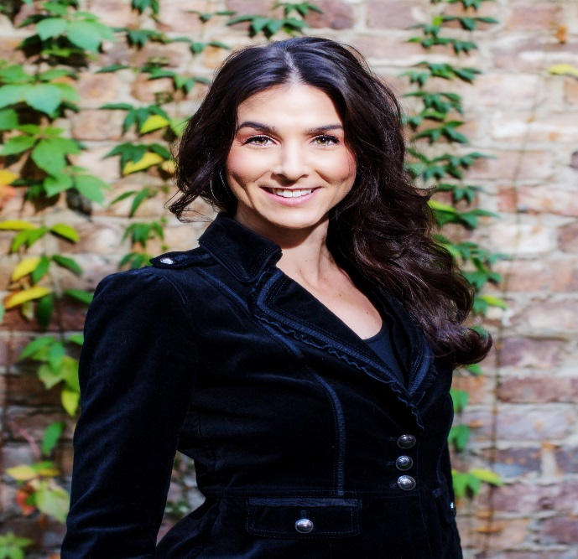
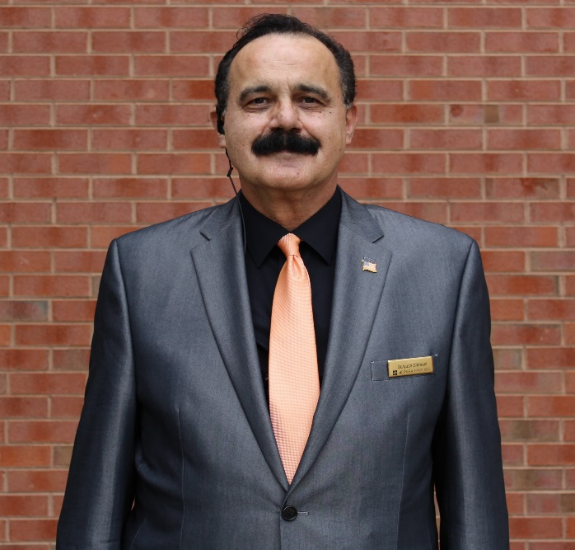
Meet The Team
Erica Greene-Johnson
Director of Catering
Kelly Pratt
Sales Manager
Daryush Shirooni
Director of Banquets
kpratt@hiknoxdwtn.com
865-934-3084
Egreene-johnson@usa-bhi.com
865-934-3291
dshirooni@usa-bhi.com
865-934-3311
“True hospitality consists of giving the best of yourself to your guests.”
— Eleanor Roosevelt

Slide 9
We Look Forward to Serving You

