Slide 1
Designer Name
AMAZON CONFIDENTIAL
Designer Name
Designer Name

Slide 3
Amazon Business Buyer Training

Slide 4
Table of Contents
Joining the Amazon Business Account
Shopping on Amazon Business
Error Messages
Halted Orders
Punchout Restrictions
Business Account Navigation
Account Configuration
Checkout
Guided Buying
Amazon Business Analytics
Your Orders
Business Customer Support

Slide 5
Joining the Amazon Business Account

Slide 6
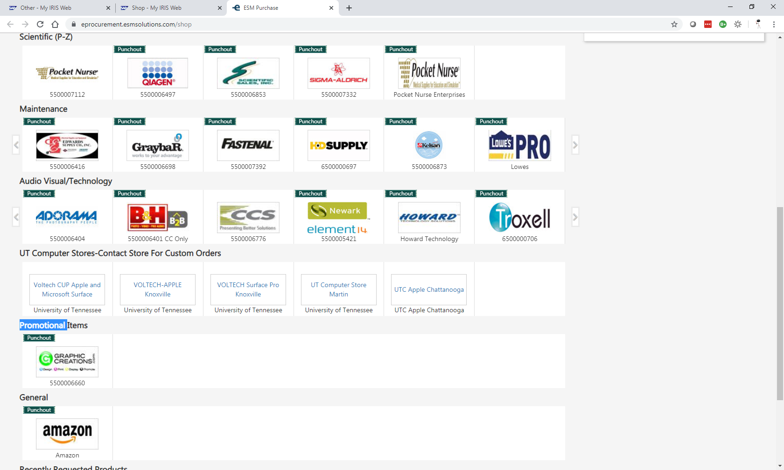
Accessing the Account through ESM
Accessing the Amazon Business account is simple for end users when Amazon is integrated with your organization’s Punchout
How do end users sign in?
To access the centralized account, click on the Amazon tile within ESM.
Depending on how you have used your work email on Amazon in the past, you may need to take action to separate or migrate an existing account.
For those who have not used their work email in the past, they will be immediately authenticated into the central account.
For those who do need to take action to separate out their existing account, this is a one time process. They will be authenticated automatically each subsequent time.

Slide 7
New to Amazon

Slide 8
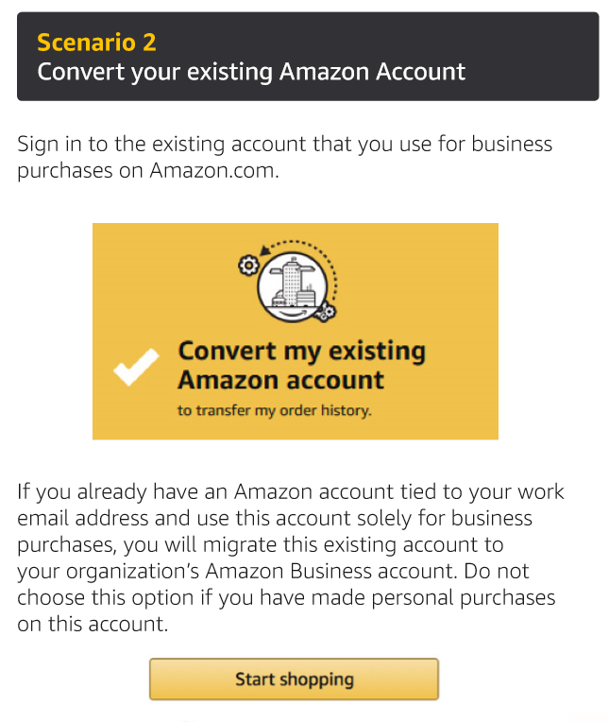
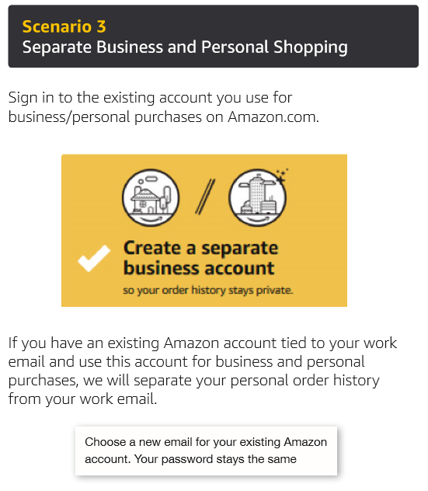
Existing Account with Work Email
OR

Slide 9
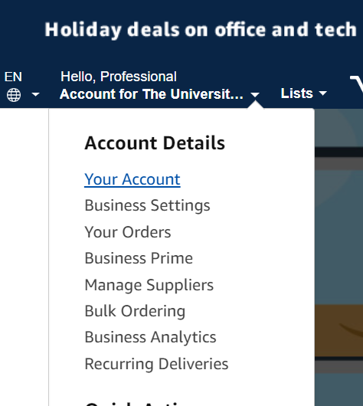
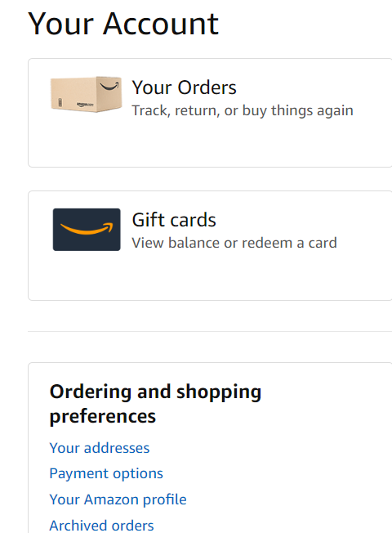
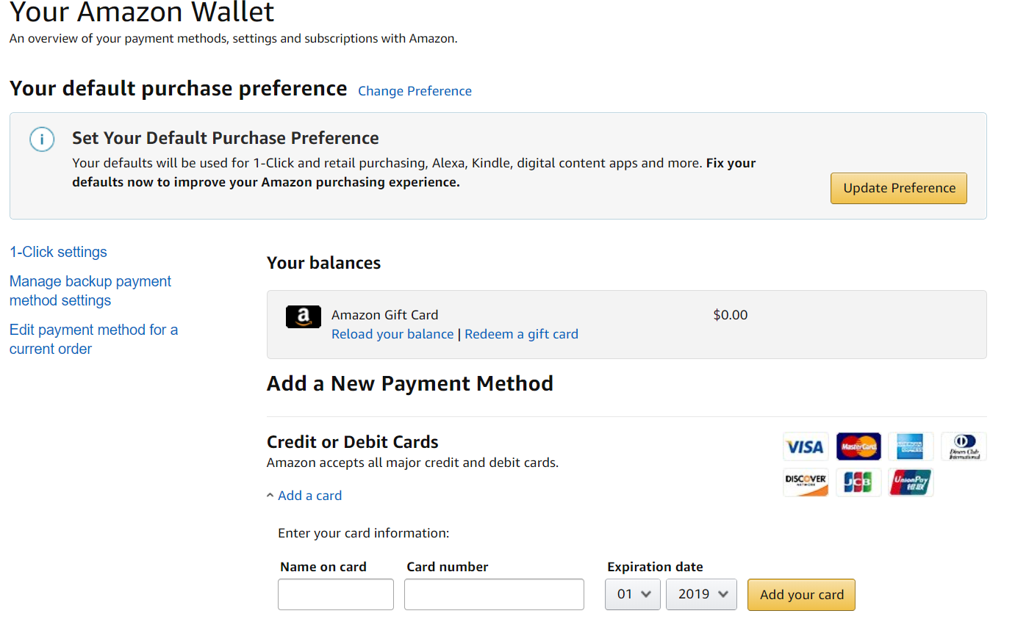
Adding Payment Method
Select “Your Account”
Click “Payment Options”
Add Pcard to your Wallet

Slide 10
Shopping on Amazon Business

Slide 11
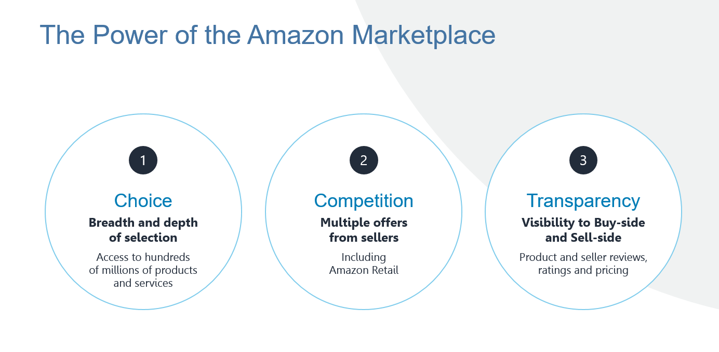

Slide 12
Amazon Business Benefits
Business Pricing & Quantity Discounts
Business pricing and quantity discounts are only available to registered business account customers on Amazon. Click to learn more.
Business Prime Shipping
Once Business Prime Shipping has been purchased, it provides Free Two-Day Shipping on eligible items for all users in the business account. There are multiple pricing tiers to meet the needs of businesses of all sizes. Click to learn more.
Buying Policies
Customize Amazon Business to your organization’s buying standards and procedures. Features include approval workflows, negotiated pricing, and preferred suppliers and preferred products.
Business-Only Selection
Business-only selection refers to items and offers that are only available for purchase by Amazon Business customers.
Amazon Business Analytics
Use Amazon Business Analytics to view data about your orders, create and filter reports based on your business needs, and view both charts and tables. Click to learn more.

Slide 13
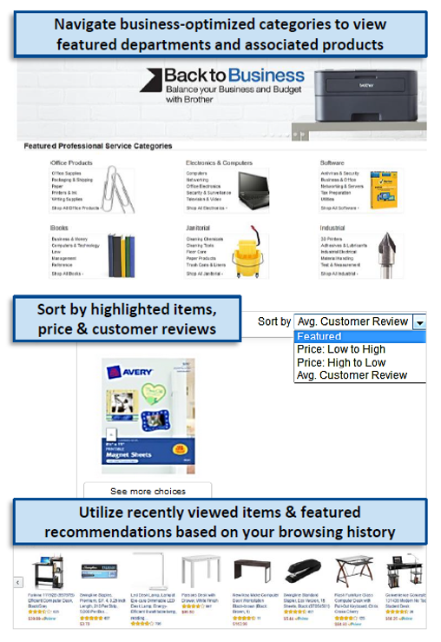
Search & Browse Optimization
Optimizing search functions in Amazon Business allows you to find the best products to meet your needs and compare prices to find the best value
Amazon is the “everything store.” With such a large selection, we do our best to make it easy for you and your end users to find what you’re looking for.
Recommended filters:
Business Sellers
Prime Eligible
Brand
Average Customer Review/Rating
Diversity Credentials

Slide 14
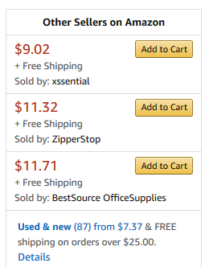
Search Optimization
Optimizing search functions in Amazon Business allows you to find the best products to meet your needs and compare prices to find the best value
Maximize Savings! Search All Departments & try using generic descriptors instead of brand names
Consider refining search results with filters available of left side of your screen, such as Prime or Business Seller
Sort results by options listed on the top left of your screen, such as Price: Low to High
In many cases, you can also Select Quantity Discounts to review quantity discounts and purchasing options
To compare offers, scroll down & select Used & new to pull up the Offer Listing page
Notes:
We simply preferred items based on the most frequently purchased items- add or remove based on the reason why. Ex: preferred this item because it is the item we are standardizing on. Moved box over search low to high

Slide 15
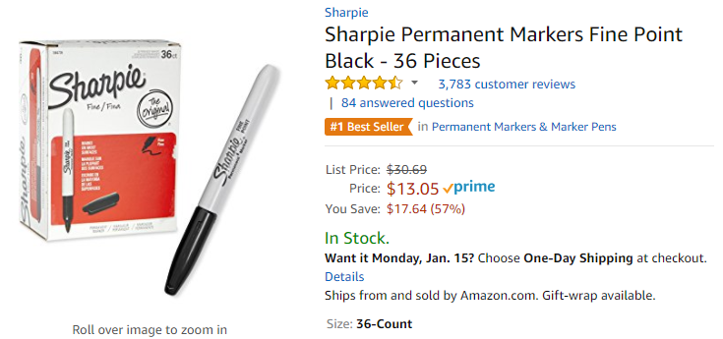
Take Advantage of Amazon Prime Shipping Benefits
An easy way to ensure that your products arrive on time and as expected, is to order products fulfilled directly from Amazon. All products clearly mark who the seller is on the product detail page.
Prime Eligibility – Fulfilled by Amazon
Prime eligible items are fulfilled by Amazon. We recommend searching for prime eligible items.
What’s not Included?
Business Prime Shipping does not include additional Prime benefits such as Amazon Fresh, Pantry, Video, or Music.

Slide 16
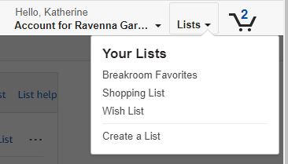
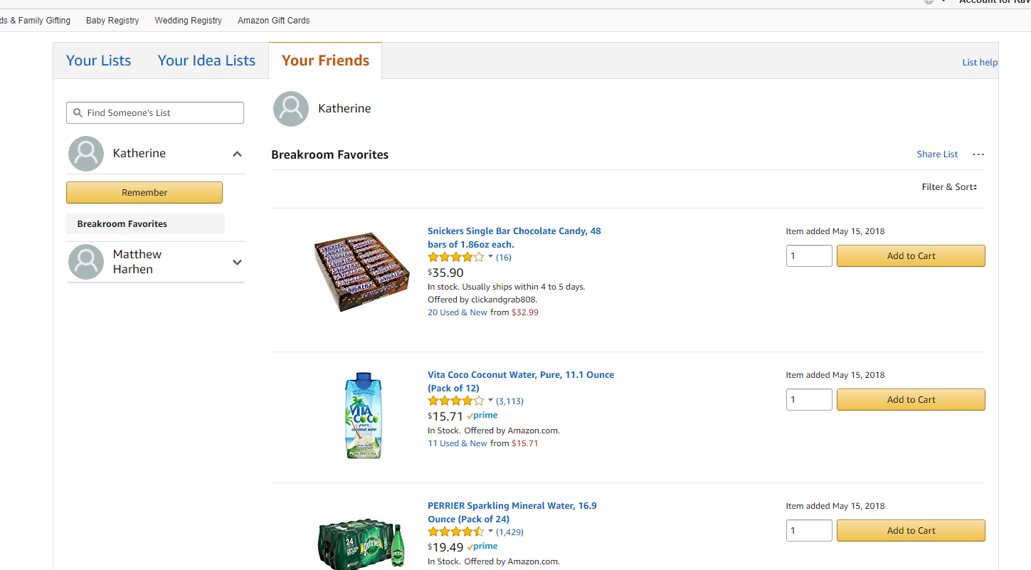
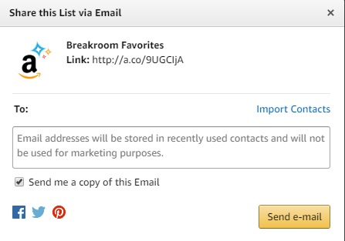
Reorder & Shopping Lists
How do lists work on Amazon Business?
Lists make it easy to keep track of the things you need and are easy to share with others. Any User on Amazon Business can create a shopping list
Choose between multiple list types depending on if you want the items to remain on a list after they are ordered
To share your list, create a public list and use the URL to email it directly to your desired audience
When a list is shared with you, you can save it to your own account or make a copy to edit yourself
Out of stock inventory

Slide 17
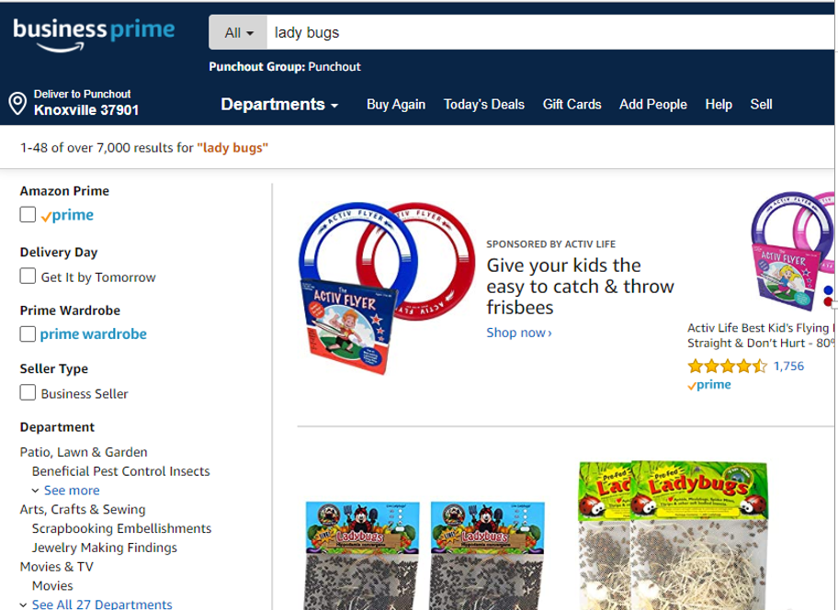
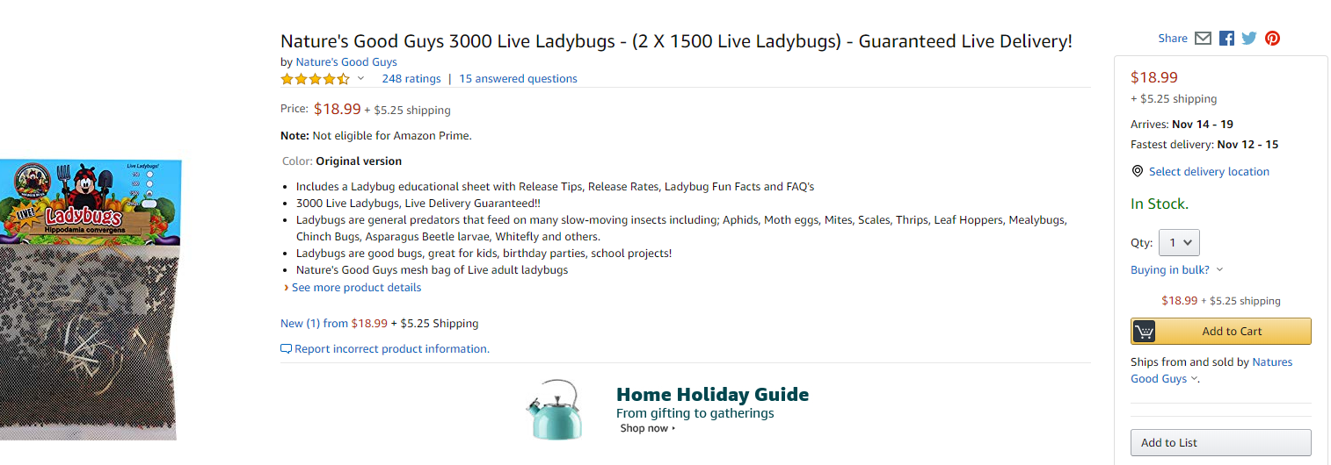
Step by Step
1
Search for the item you wish to purchase
Add the item to your cart
Submit cart for approval
2
3

Slide 18
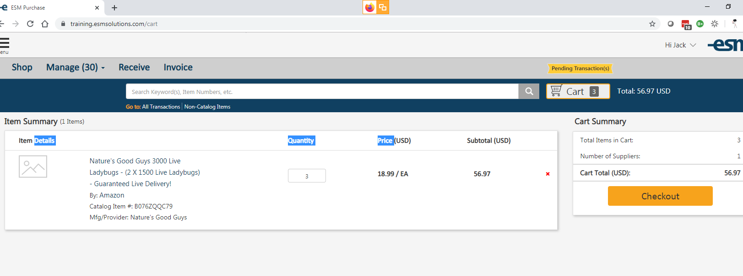
Continued in ESM
Verify everything is correct and select “Checkout”

Slide 19
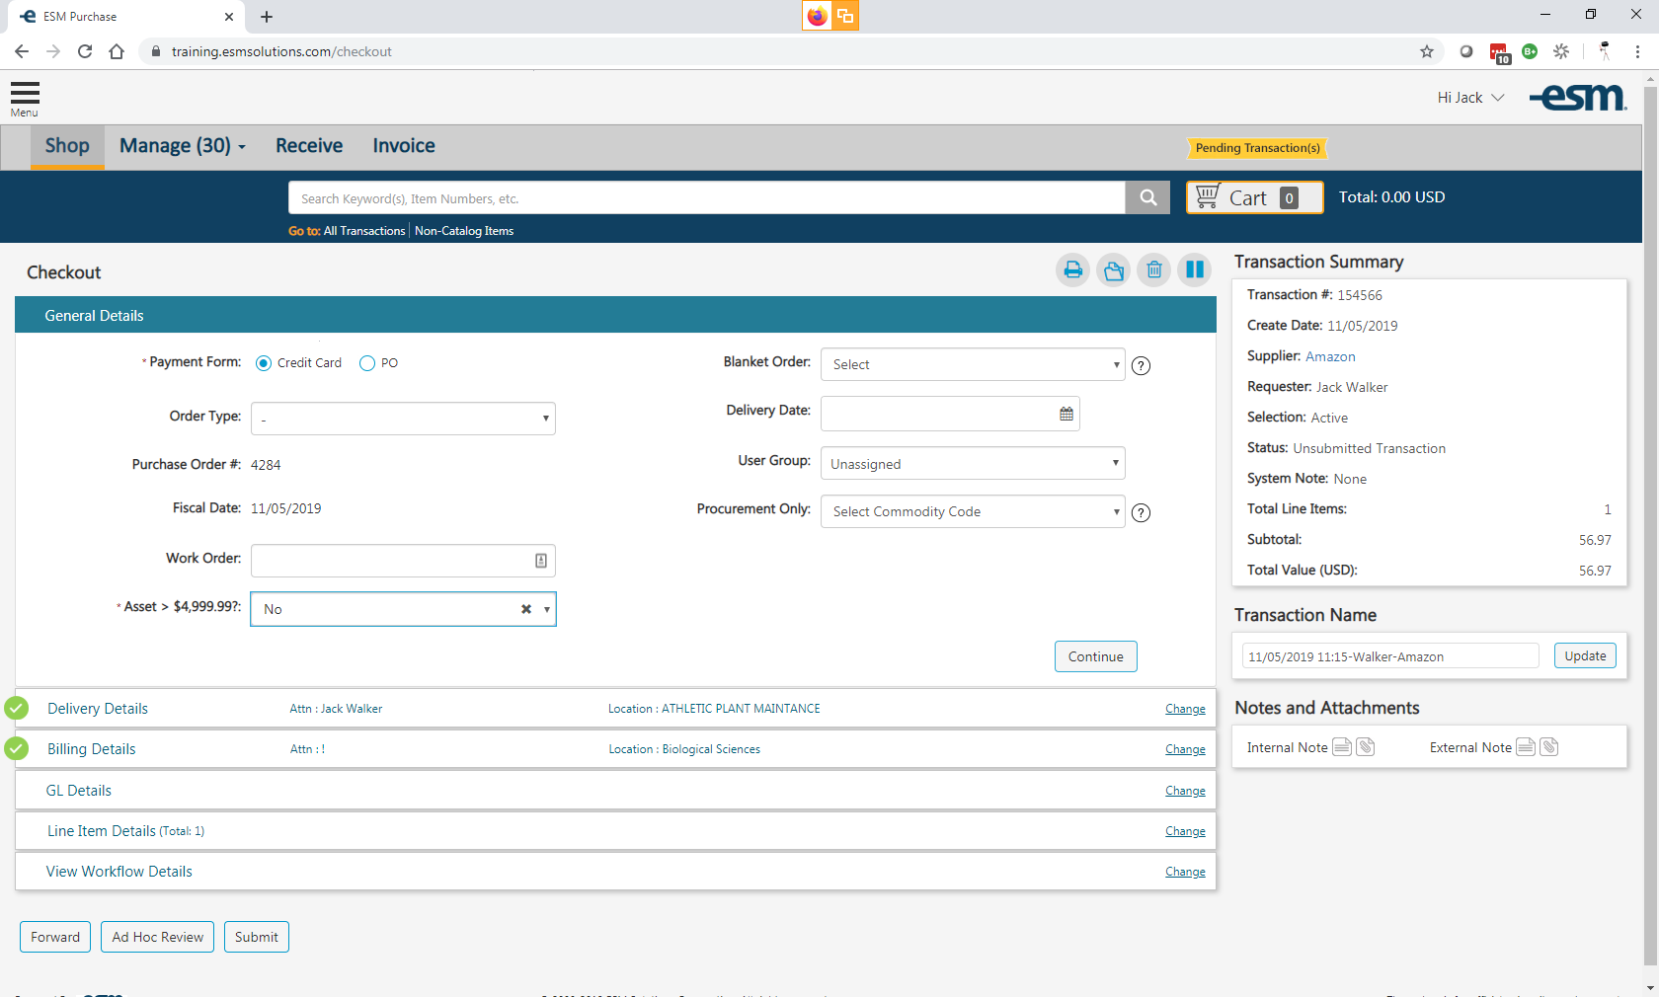
GL Details
Select Payment Form and Asset before selecting Continue

Slide 20
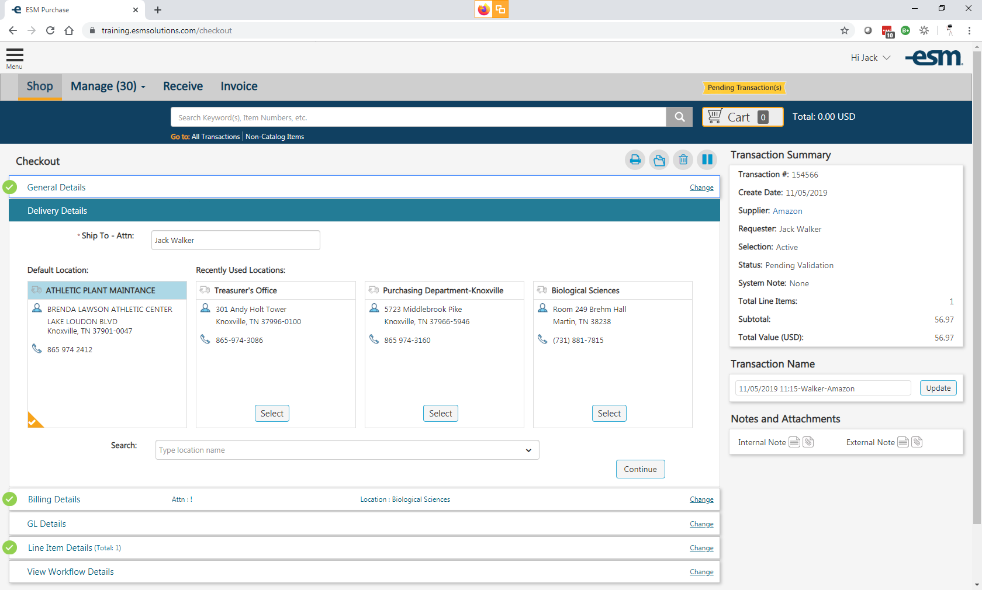
Delivery Details
Select desired shipping address

Slide 21
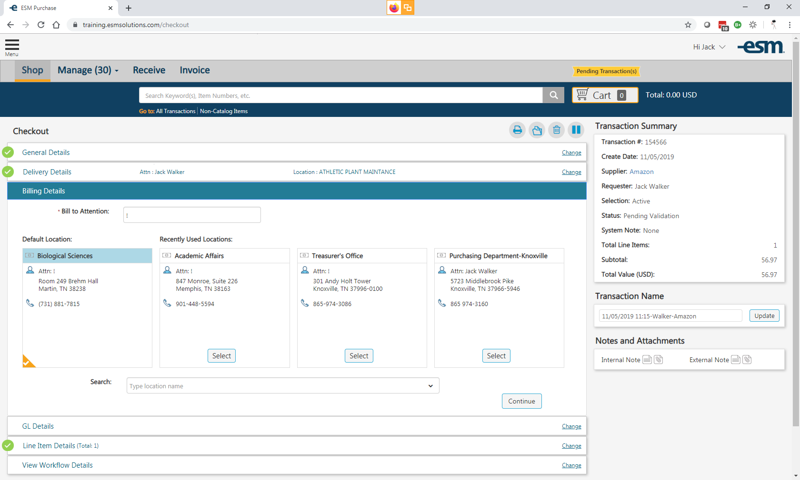
Billing Details
Select Bill to Attention

Slide 22
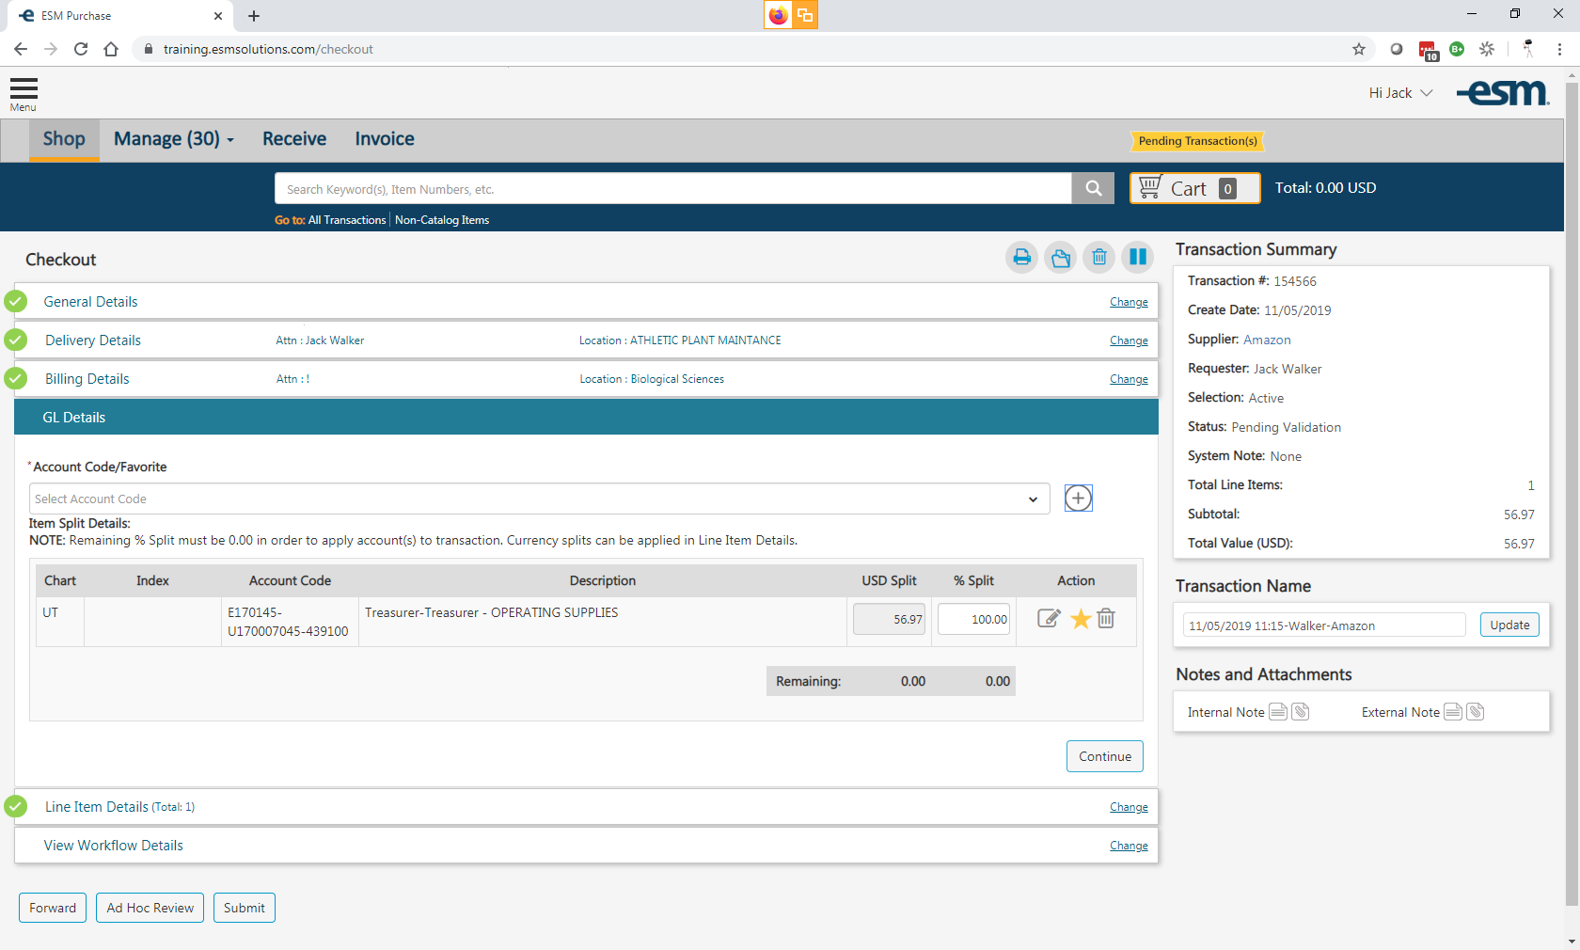
GL Details
Select Account Code/Favorite

Slide 23
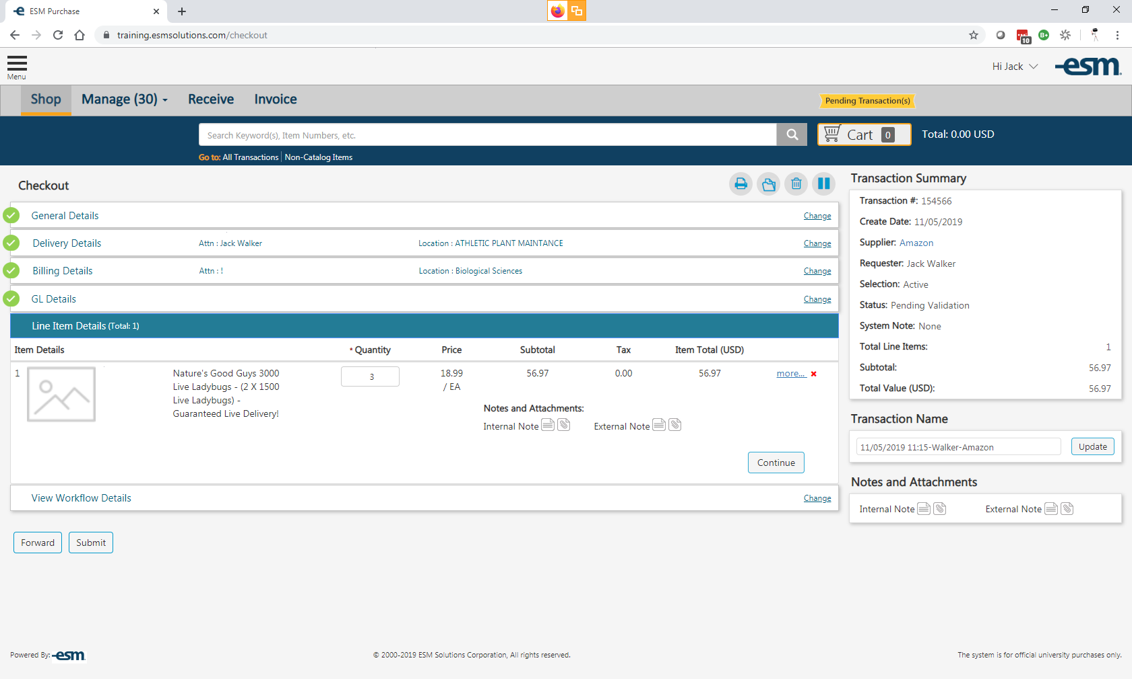
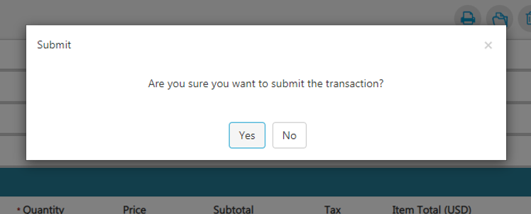
Line Item Details
Review order and submit

Slide 24
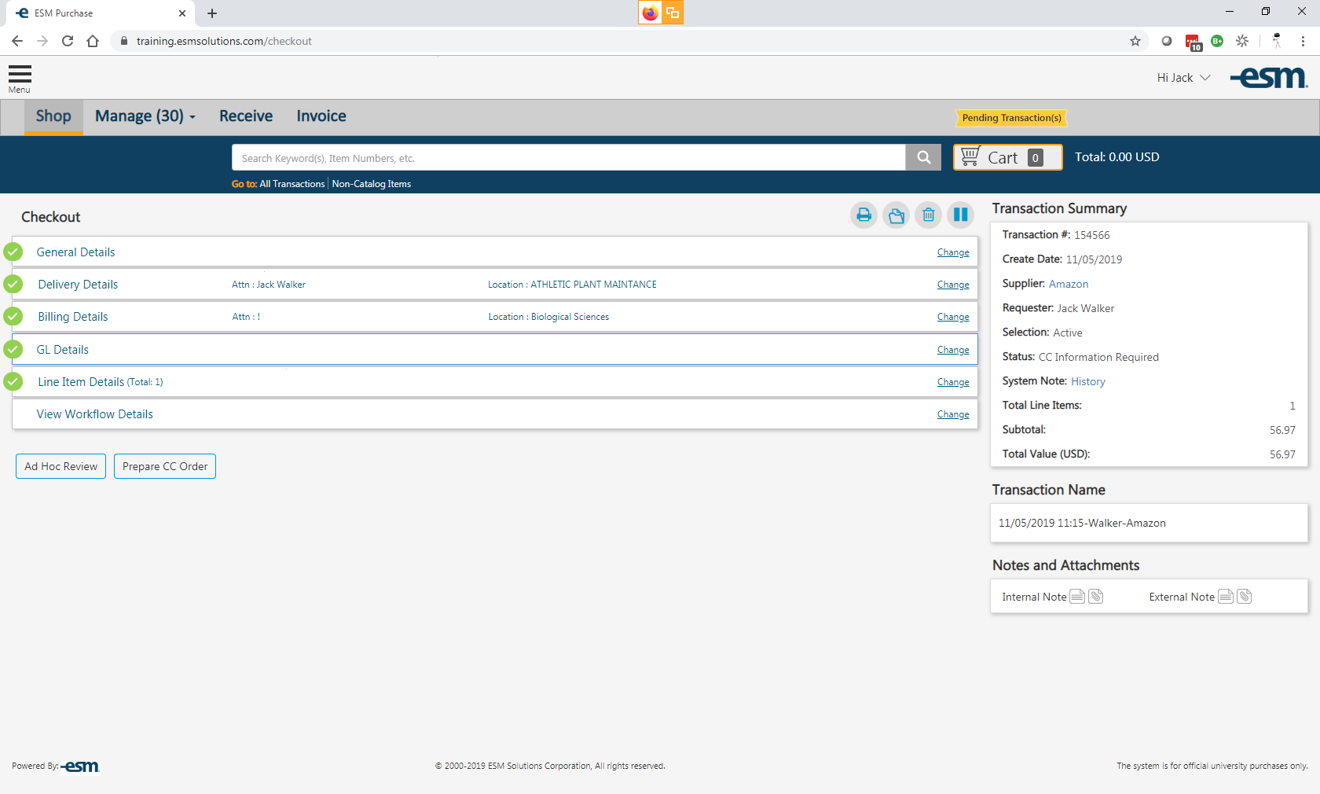
View Workflow Details
Select Prepare CC Order

Slide 25
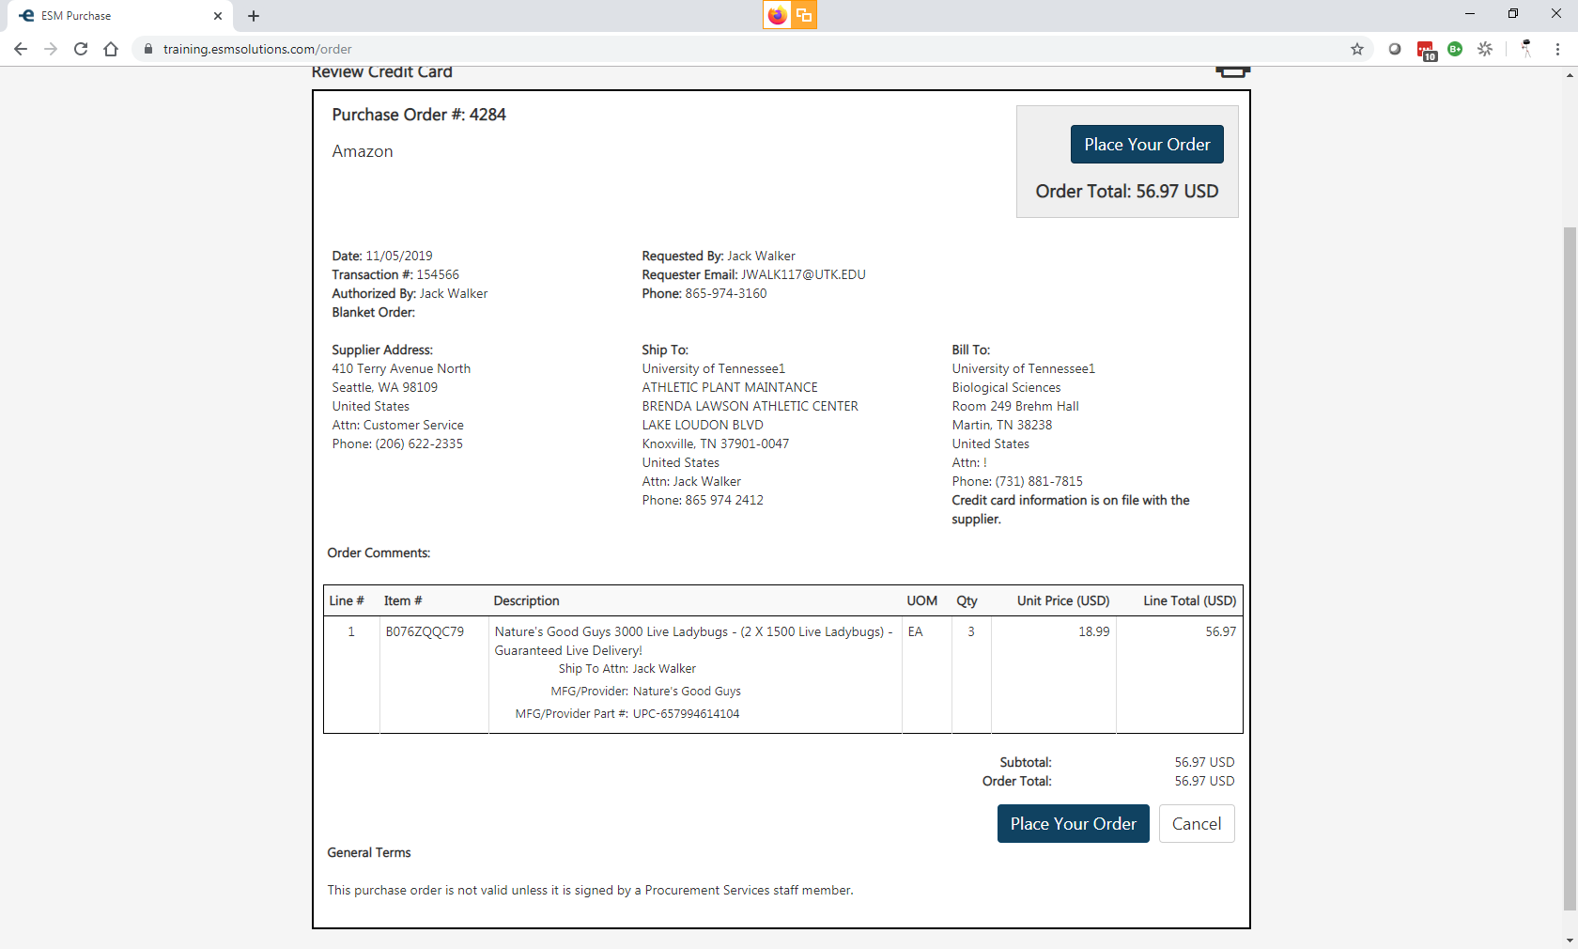
Review Credit Card
Review your order one final time before selecting Place Your Order

Slide 26
Error Messages

Slide 28
Halted Orders

Slide 30
Punchout Restrictions

Slide 31
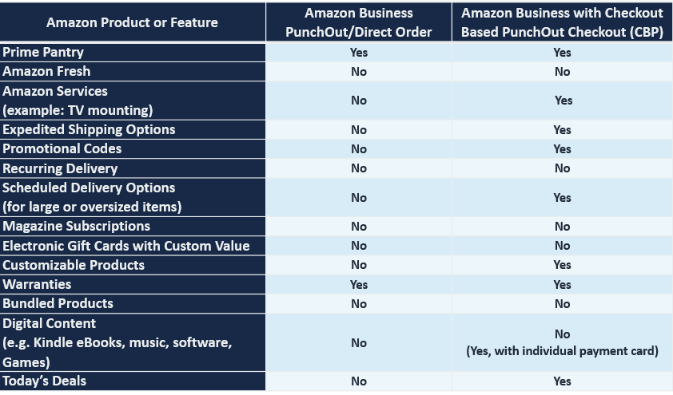
Punchout Supported Products and Features Not all products available on Amazon Business are supported for purchase through Punchout. However, Checkout Based Punchout (CBP) unlocks many otherwise unavailable products and features

Slide 32
Business Account Navigation

Slide 33
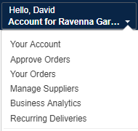
Business Account Navigation
Page | Functionality
Your Account | Standard Amazon account information
Approve Orders | If workflow approvals are enabled, approvers can view and take action on pending orders
Your Orders | View and track your orders. Administrations can view orders others have placed on behalf of the organization
Manage Suppliers | Easily find suppliers on Amazon Business and add them to your list of Saved Suppliers. Learn more.
Business Analytics | Create and filter custom reports based on your business needs to view your organization’s orders
Recurring Deliveries | Have essential items delivered automatically, based on a schedule you choose. Learn More.

Slide 34
Account Configuration

Slide 35
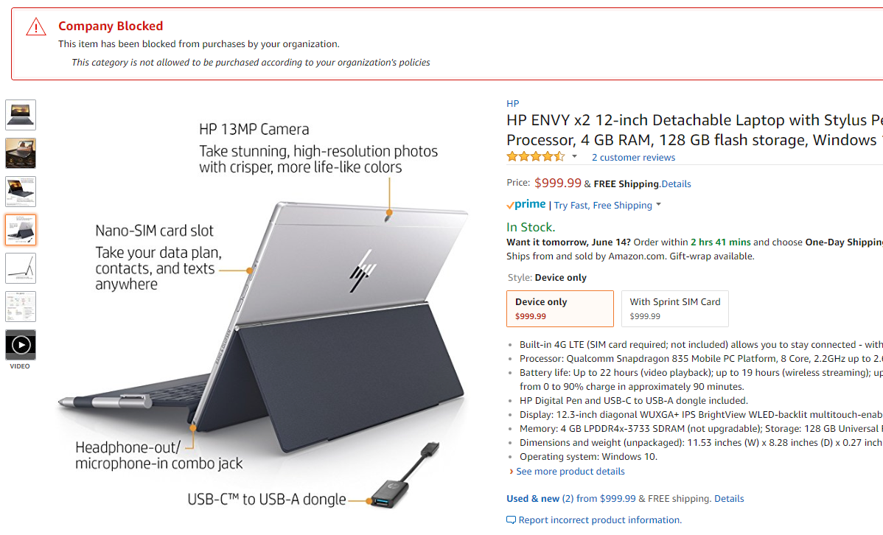
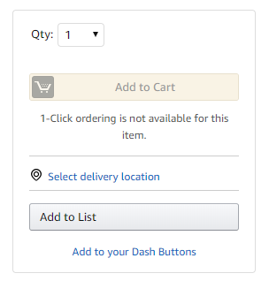
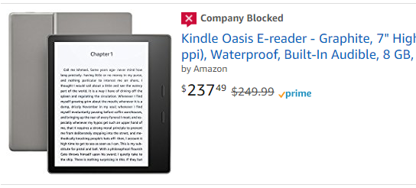
Company Blocked
Hard blocking product categories prevents an end user form adding these product to their cart. The add to cart option will appear greyed out for any product categories that are blocked

Slide 36
Business Analytics

Slide 37
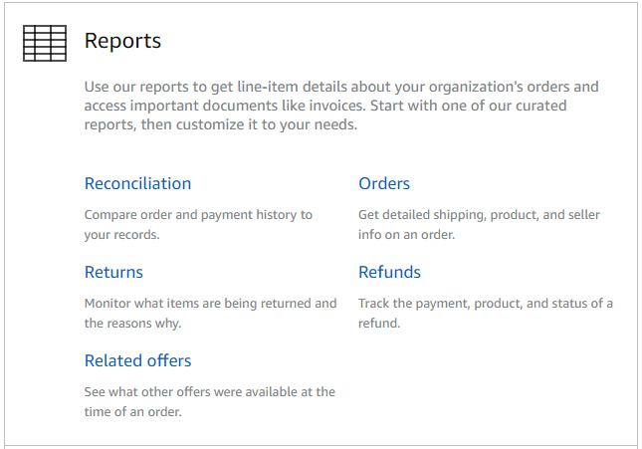
Amazon Business Analytics
Amazon Business Analytics provides the ability to:
Aggregate purchases to compare and track spend over time
Monitor and track 60+ data fields including customer info, shipment info, payment info, and seller info
Customize and save report templates to meet business needs
Download CSV files to analyze your data in excel

Slide 38
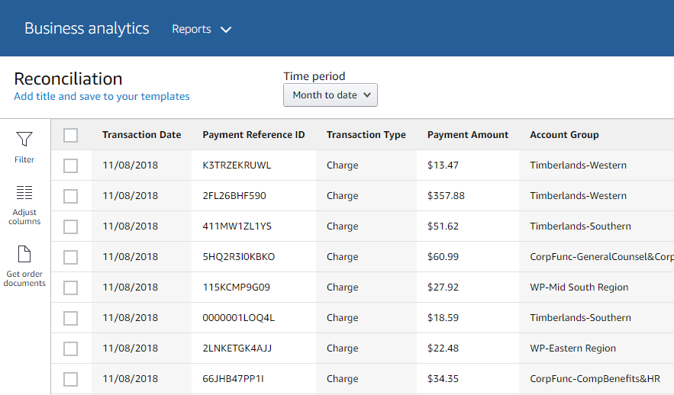
Reporting & Reconciliation
Use the Reconciliation Report to view data including transaction info, customer info, and order info.
Simplify the reconciliation process by matching corporate credit card charges to each item in a shipment.
Match the Payment Reference ID in the Reconciliation Report against your credit card statement
Customize report columns and filters at the left to find required information

Slide 39
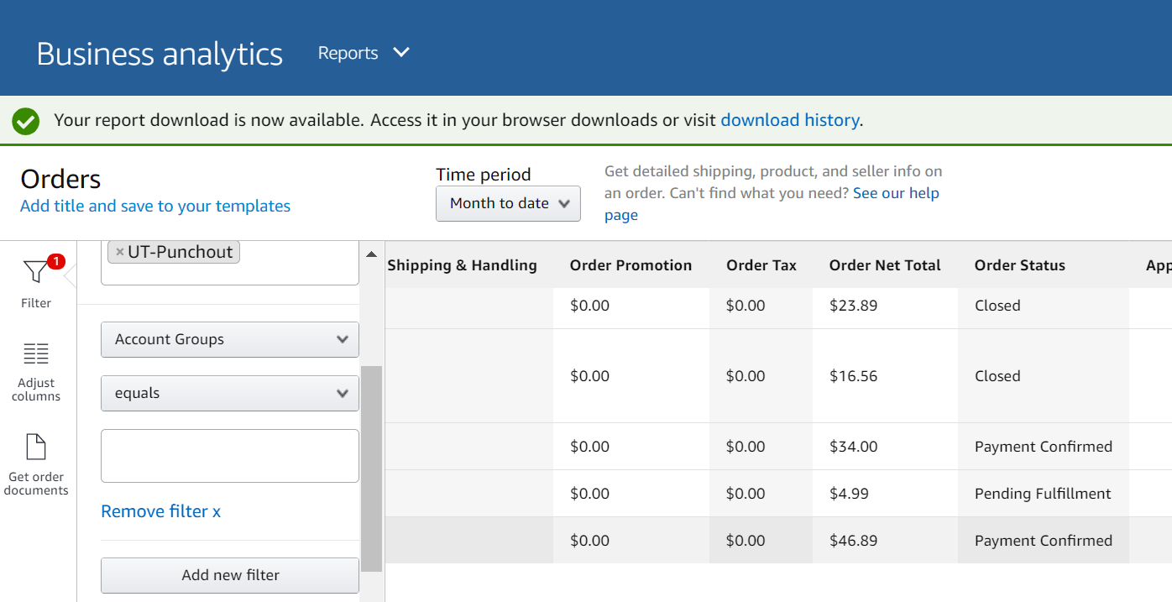
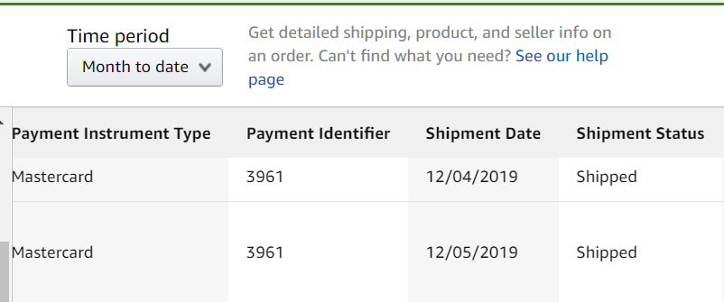
Order Status
Use the Order Report to view
order status and shipment status
Running Order Report
Go to Business Analytics
Select Orders Report
Within Orders filter by time period
Review order in reference and scroll report to the right to see Order & Shipment Status

Slide 40
Your Orders

Slide 41
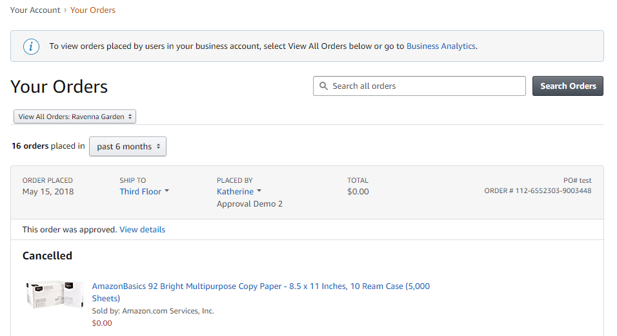
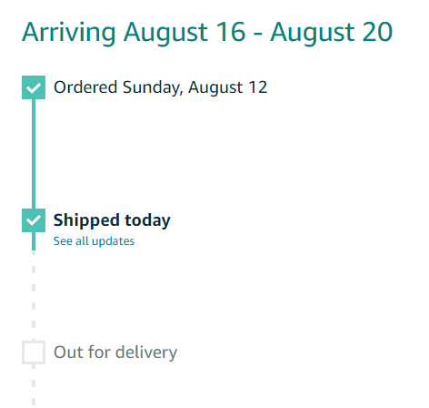
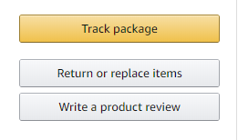
Your Orders
This section of the account provides additional detail regarding the status of all orders placed
Take a variety of actions on your orders such as initiating returns or tracking the delivery of a package.

Slide 42
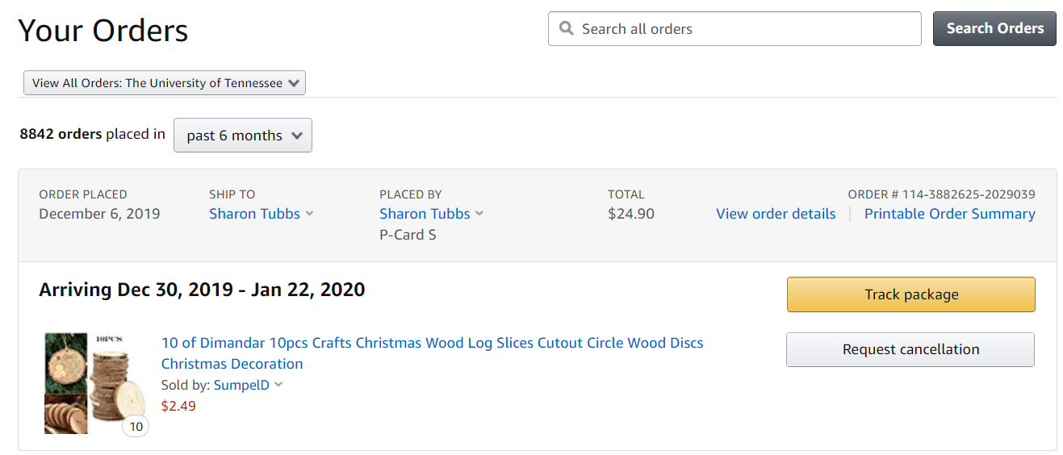
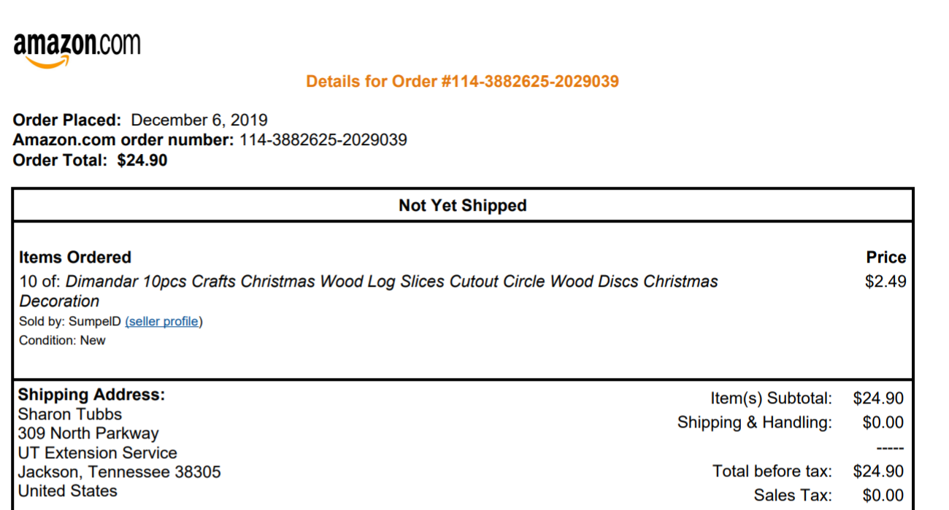
Your Orders - status
To track/check status of orders to go Your Orders tab and select View Order Details or Printable Order Summary

Slide 43
Business Customer Support

Slide 44
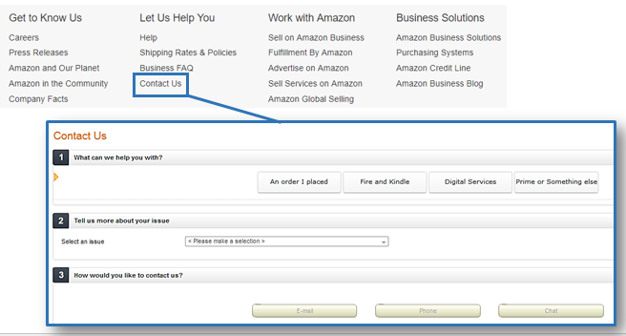
Business Customer Support
Dedicated U.S. based Business Customer Support can be reached a number of ways including email, chat and phone.
Not sure what you’re looking for? Learn more about the features and benefits on Amazon Business HERE.

Slide 45
Common Customer Support Questions
See below for quick resolutions to frequently asked questions from your end users as well as contact information for a variety of support resources
Contact Business Customer Support: CLICK HERE Provides end users the option to call, email, or live chat. Please use this method of contact for anything relating to an order, transaction, charge, or shipment.
Cancel an Individual Prime Membership:
Your Account > Manage My Prime Membership > End Membership
The end user must follow the steps to receive a pro-rated refund
Request a Tax Exemption Refund:
Your Orders > Locate Order > Contact Seller > Request refund through email
Additional tax queries can be emailed to tax-exempt@amazon.com
Your Customer Advisor –Johnny Przybyszewski johnnypz@amazon.com This person is your point of contact for anything related to the Amazon Business account structure, new features and functionality, and questions that do not fall into the above categories

Slide 46
Thank You

